Slide 1

Spatial Artificial Intelligence: Introduction
Yao-Yi Chiang
Computer Science and Engineering
University of Minnesota
yaoyi@umn.edu
CC-BY
Attribution

Slide 2
What is Spatial Artificial Intelligence?

Slide 3
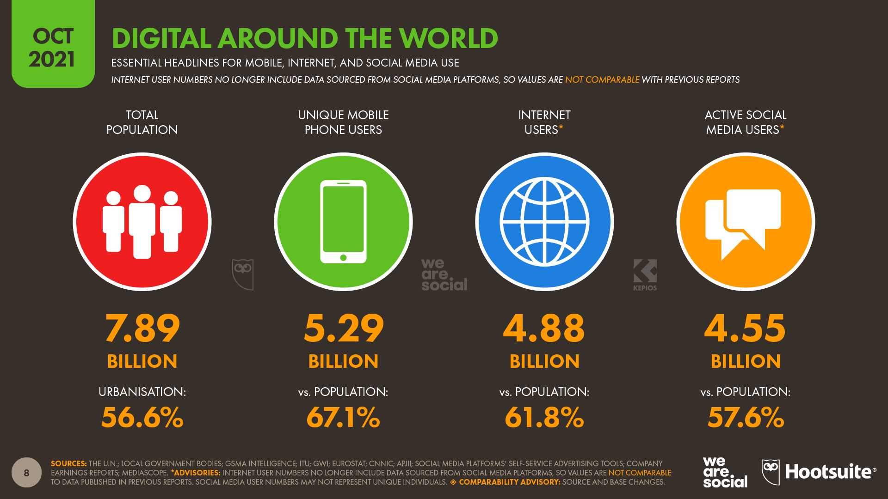
https://datareportal.com/global-digital-overview
Notes:
https://datareportal.com/global-digital-overview

Slide 4
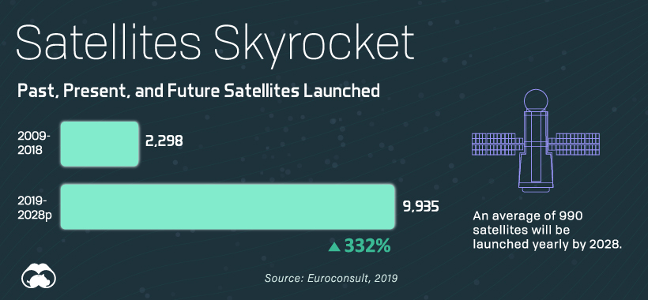
https://www.visualcapitalist.com/visualizing-all-of-earths-satellites/

Slide 5
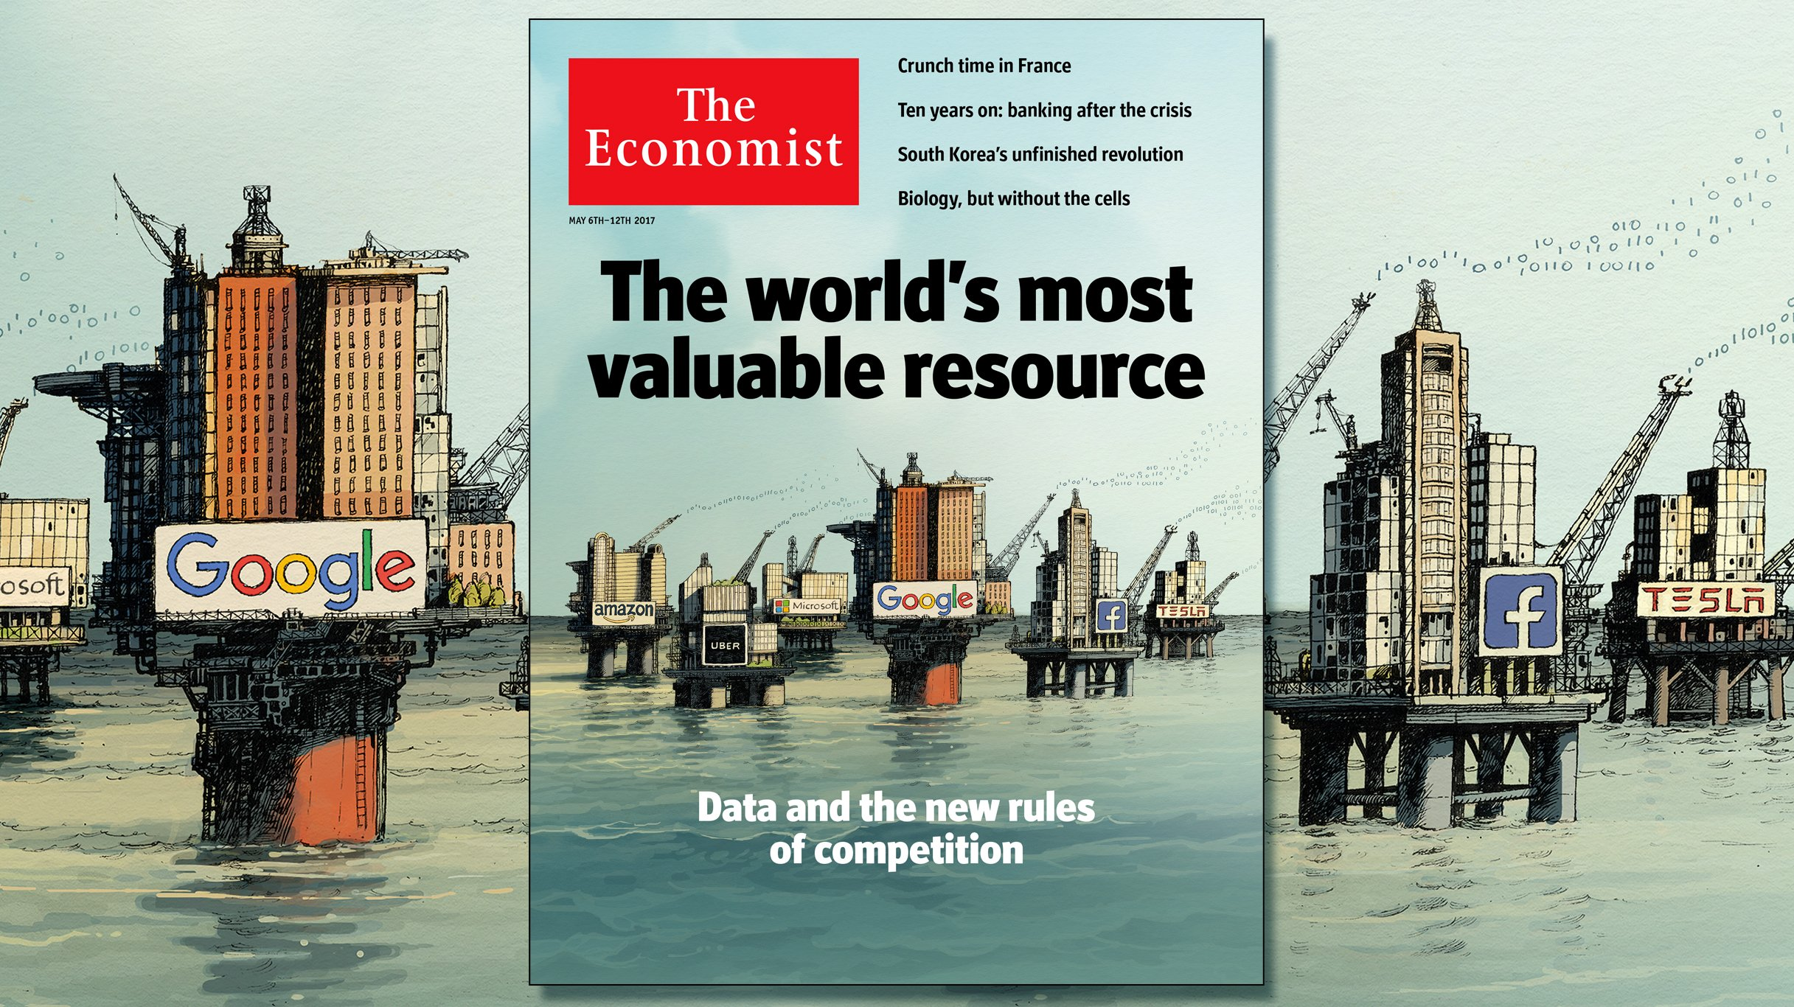
https://twitter.com/TheEconomist/status/860135249552003073/photo/1

Slide 6
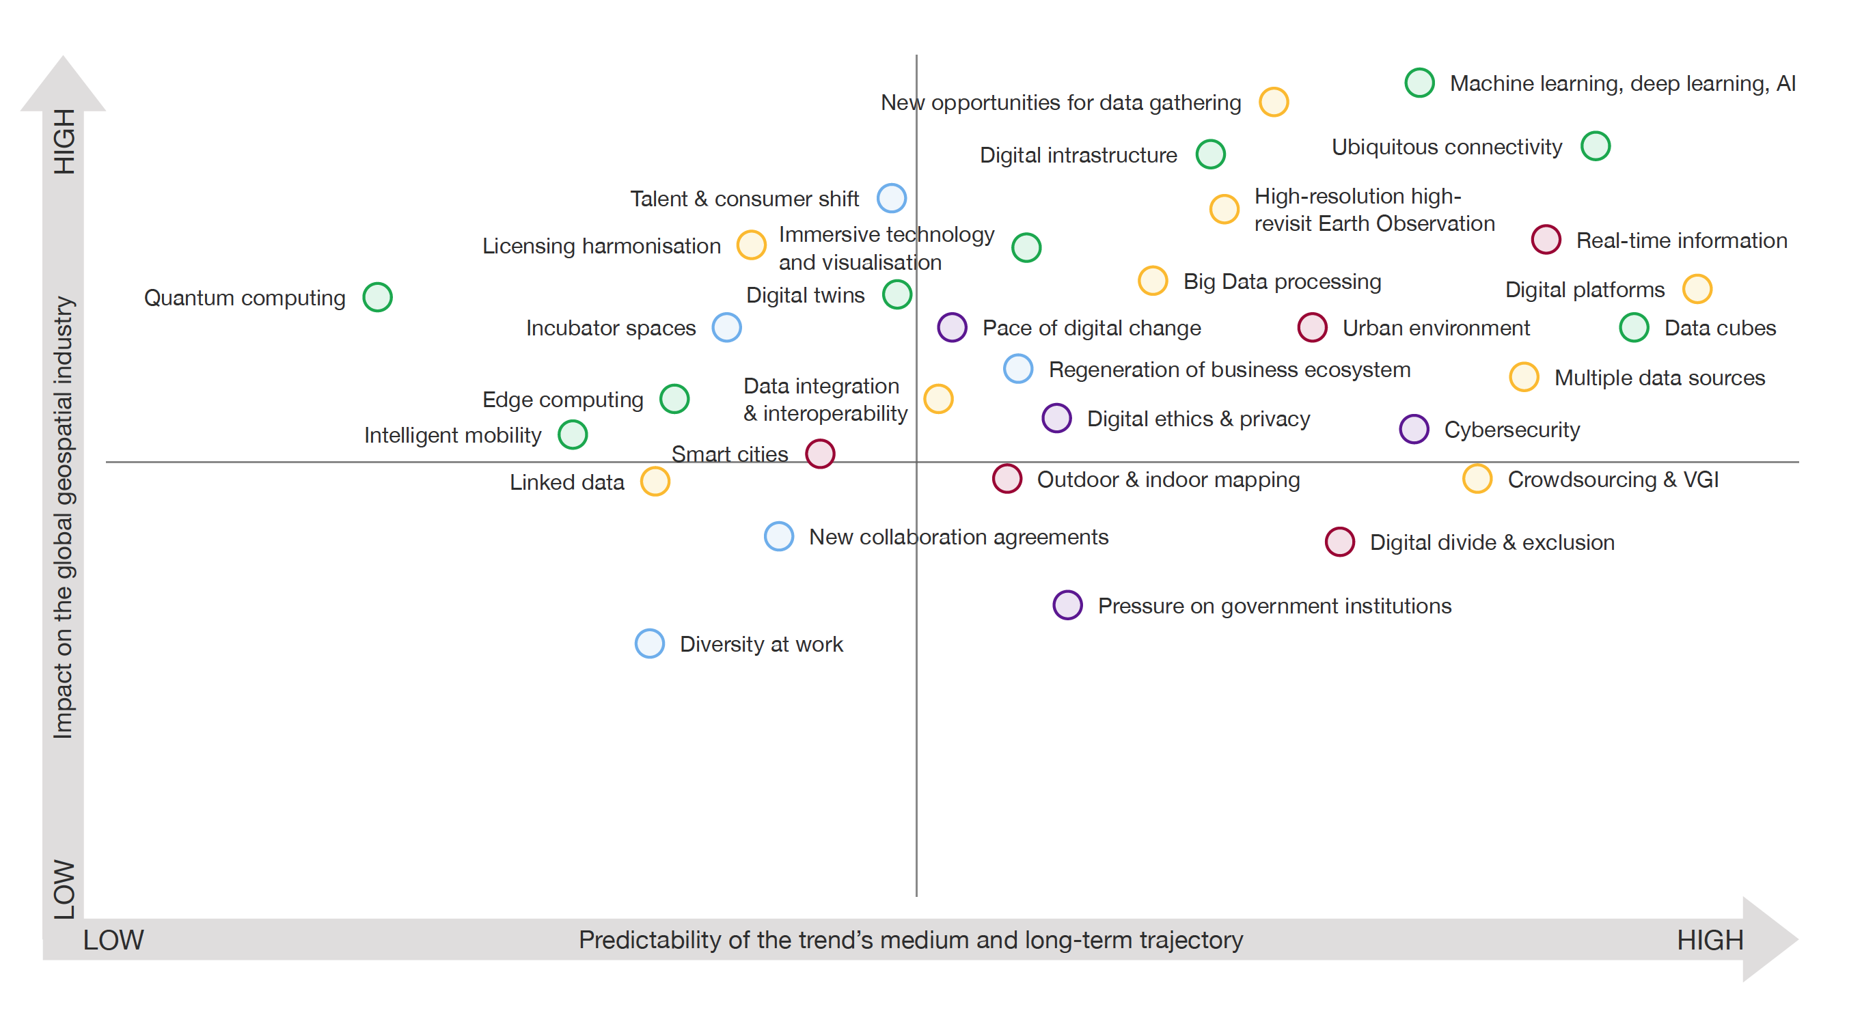
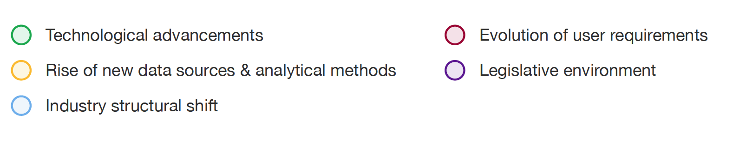
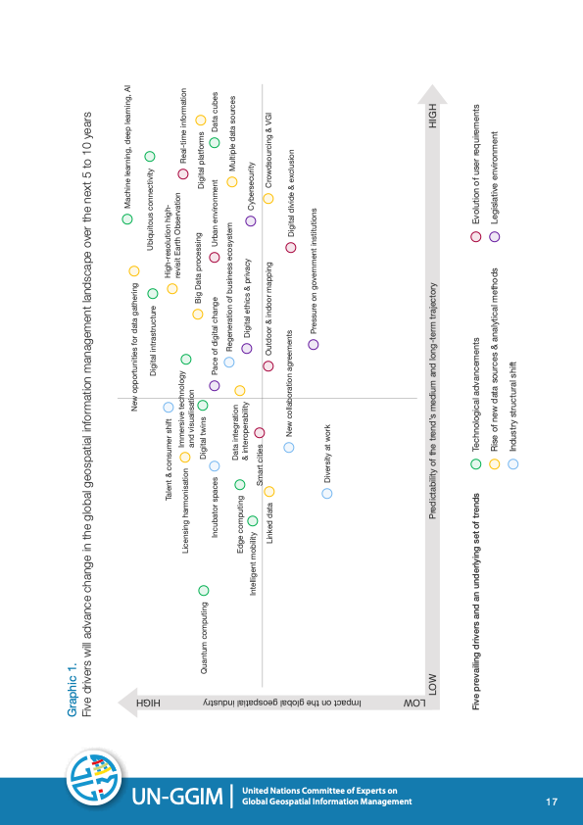
Future Trends in geospatial information management: the five to ten year vision – Third Edition, August 2020

Slide 7
What is Artificial Intelligence?
Artificial Intelligence
Data Mining
Broadly speaking, any technologies having human-like capabilities to perform certain tasks
Discovering previously unknown knowledge from BIG data
Machine Learning
(Machine) Making inference using available data without explicit rules

Slide 8
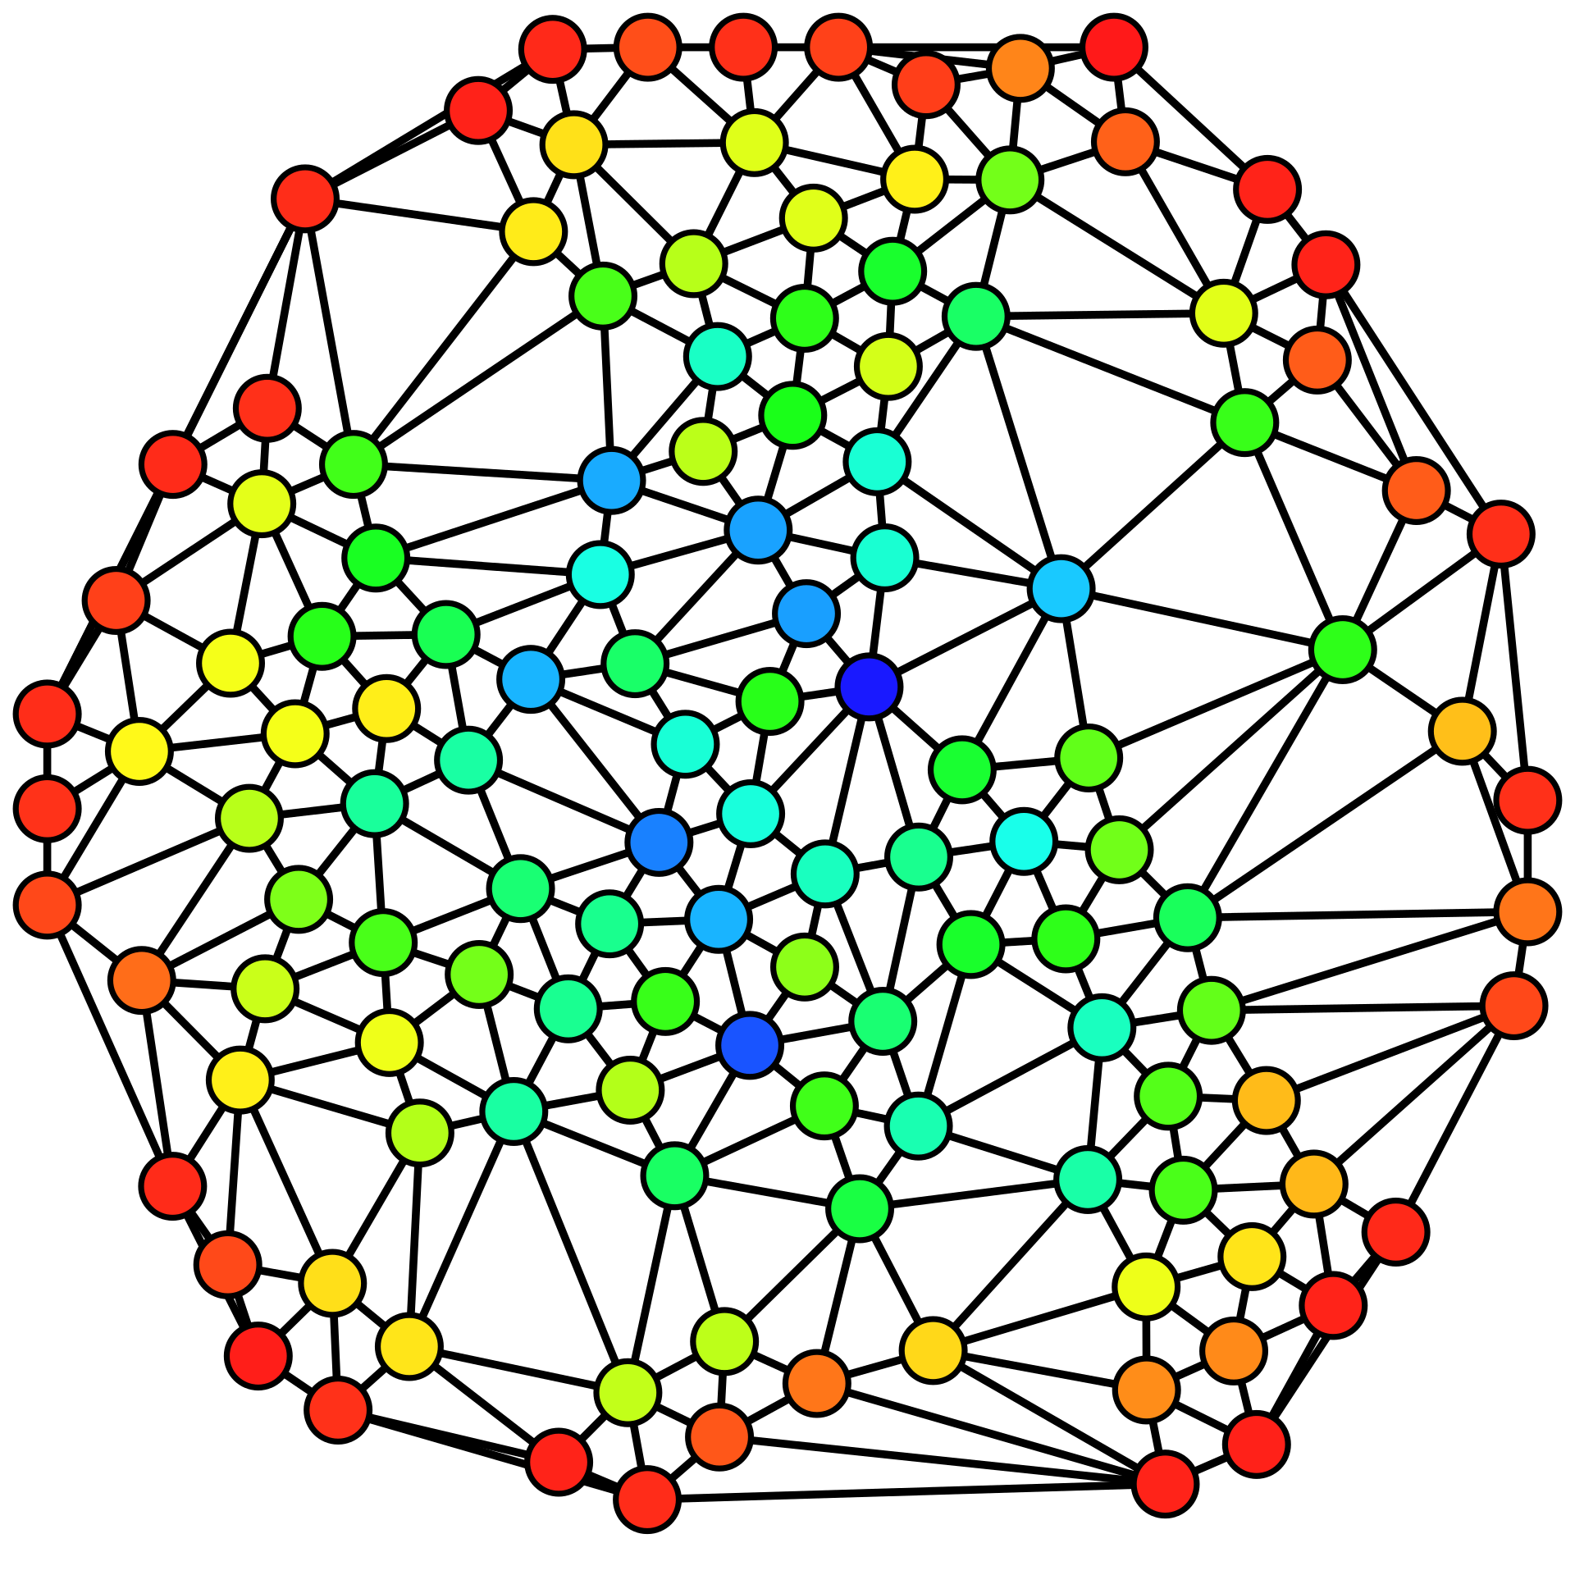
AI Tasks - Descriptive Analysis
Detect previously unknown patterns in data
e.g., split social networks into groups
https://en.wikipedia.org/wiki/Social_network_analysis#/media/File:Graph_betweenness.svg

Slide 9
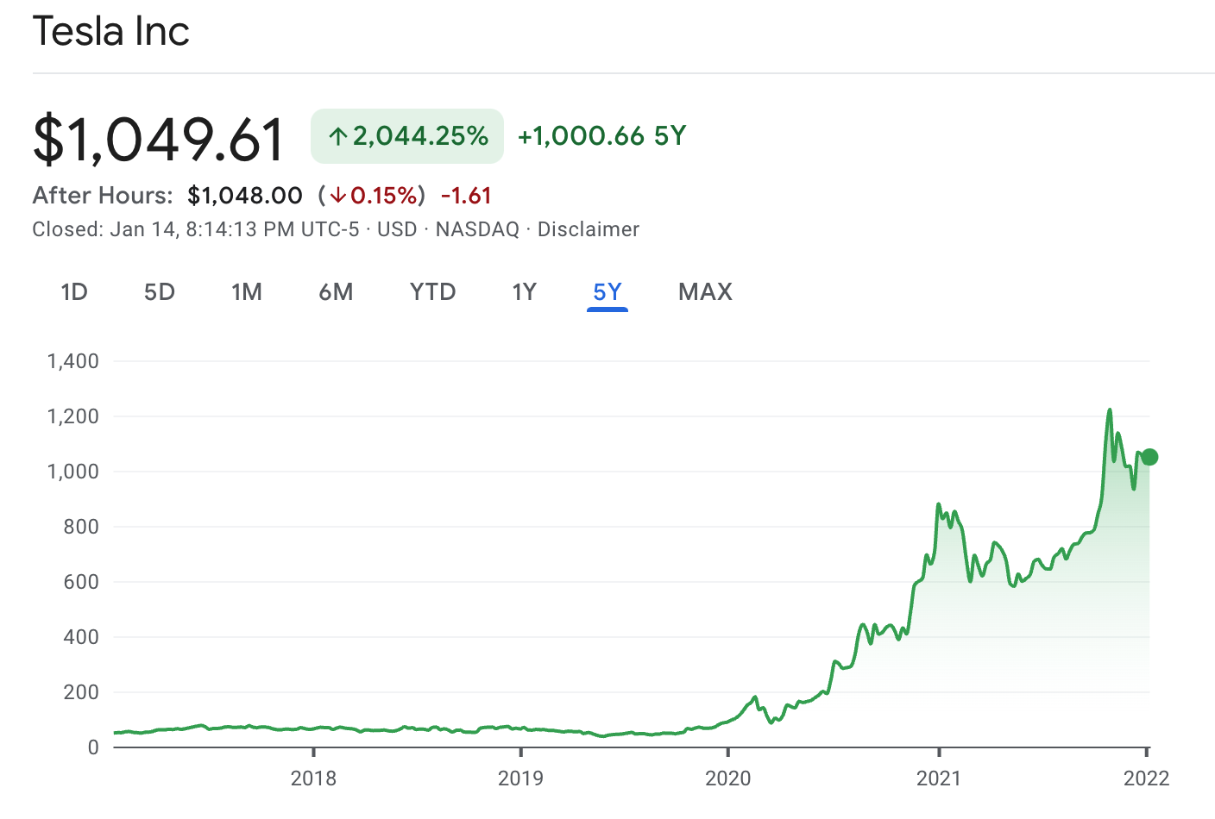
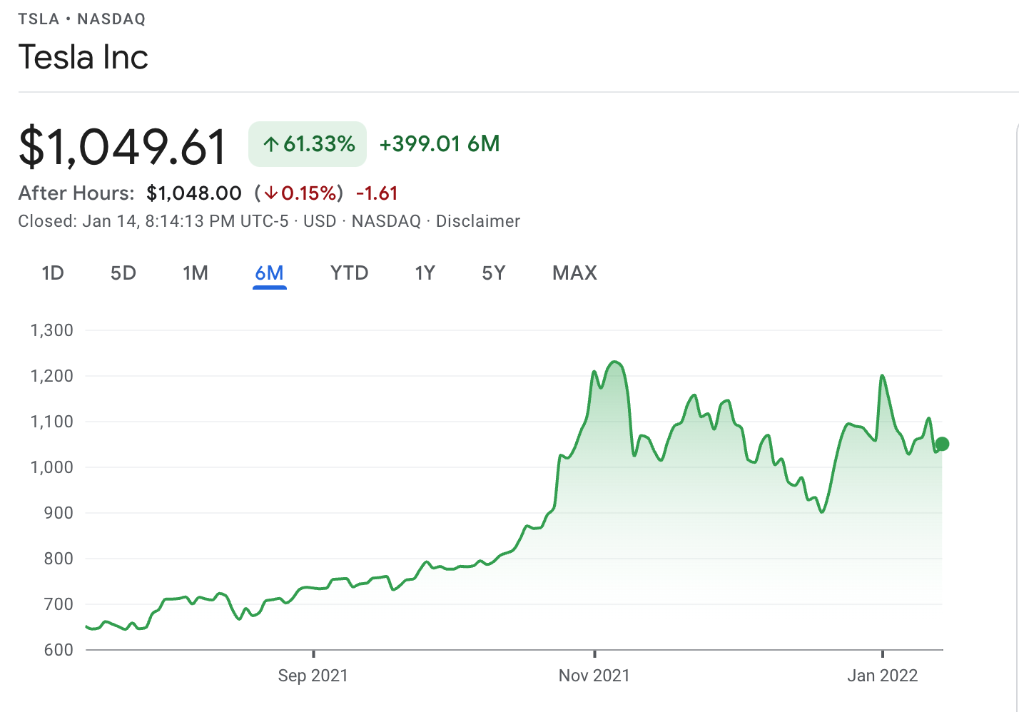
AI Tasks - Predictive Analysis
Predict unobserved data values using computer models
e.g., by learning some model parameters from some data to predict future stock prices

Slide 10
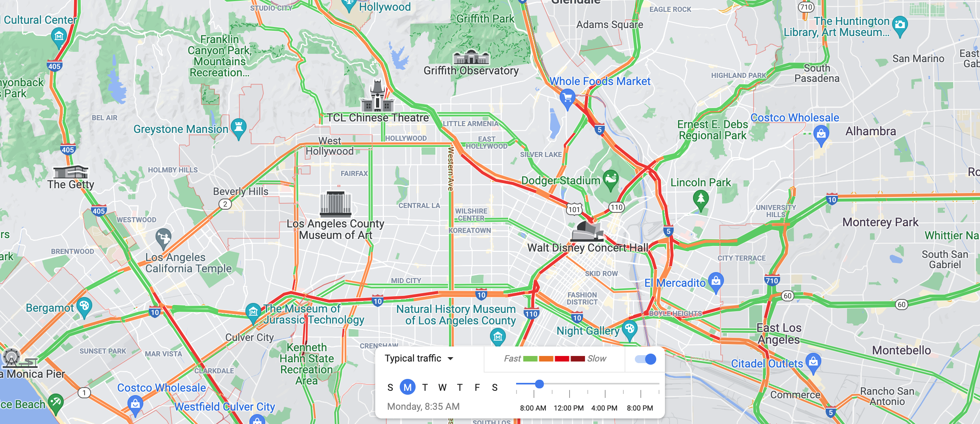
AI Tasks - Prescriptive Analysis
Examinate “What-If” scenarios and suggest actions
e.g., traffic on I-10 will be slow in the next hour, take I-210 will save 15 minutes

Slide 11
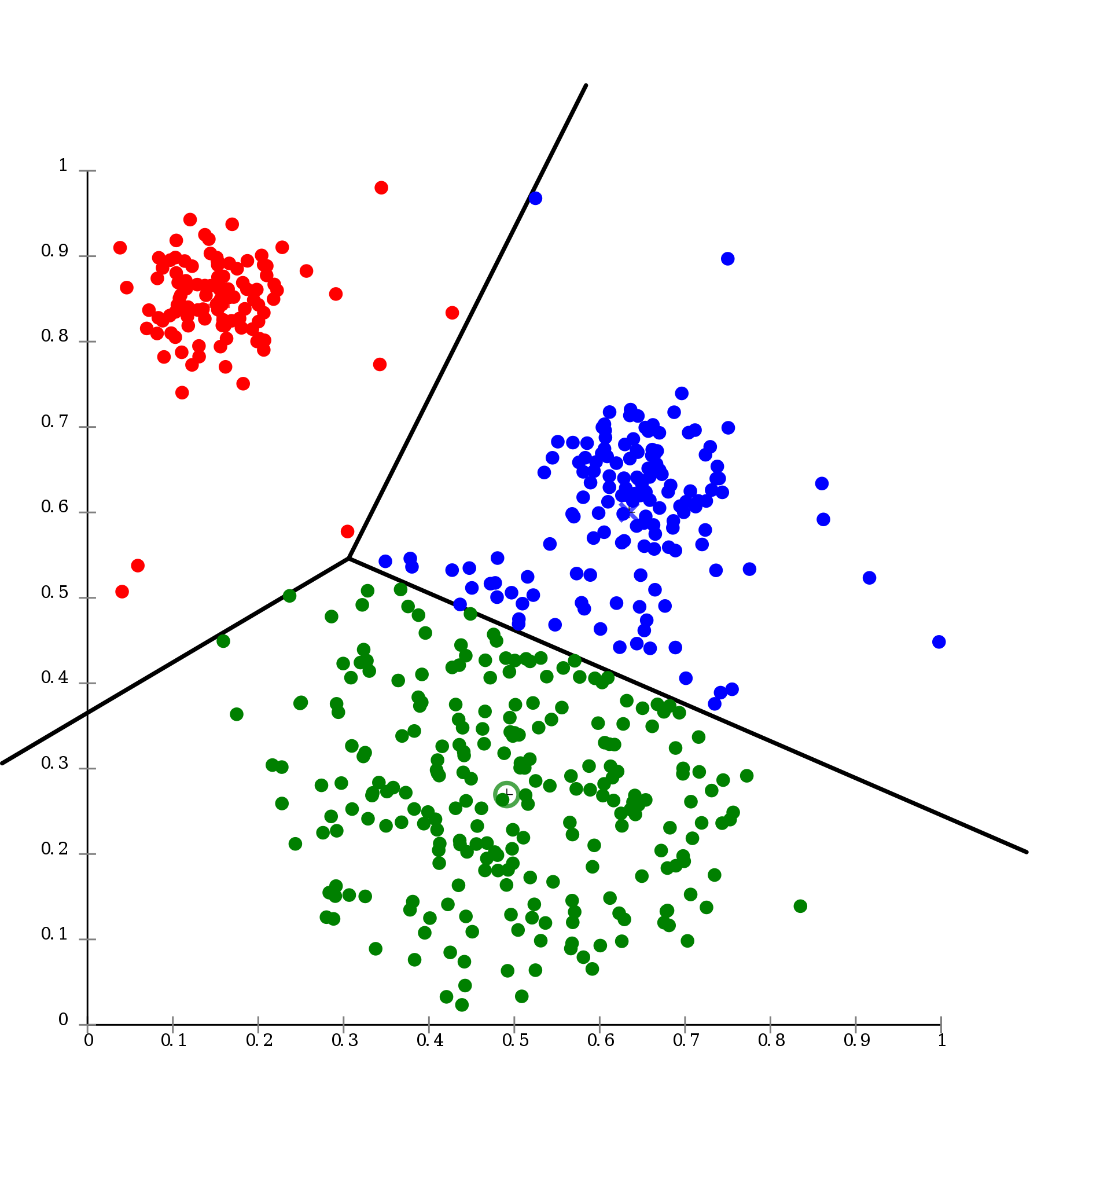
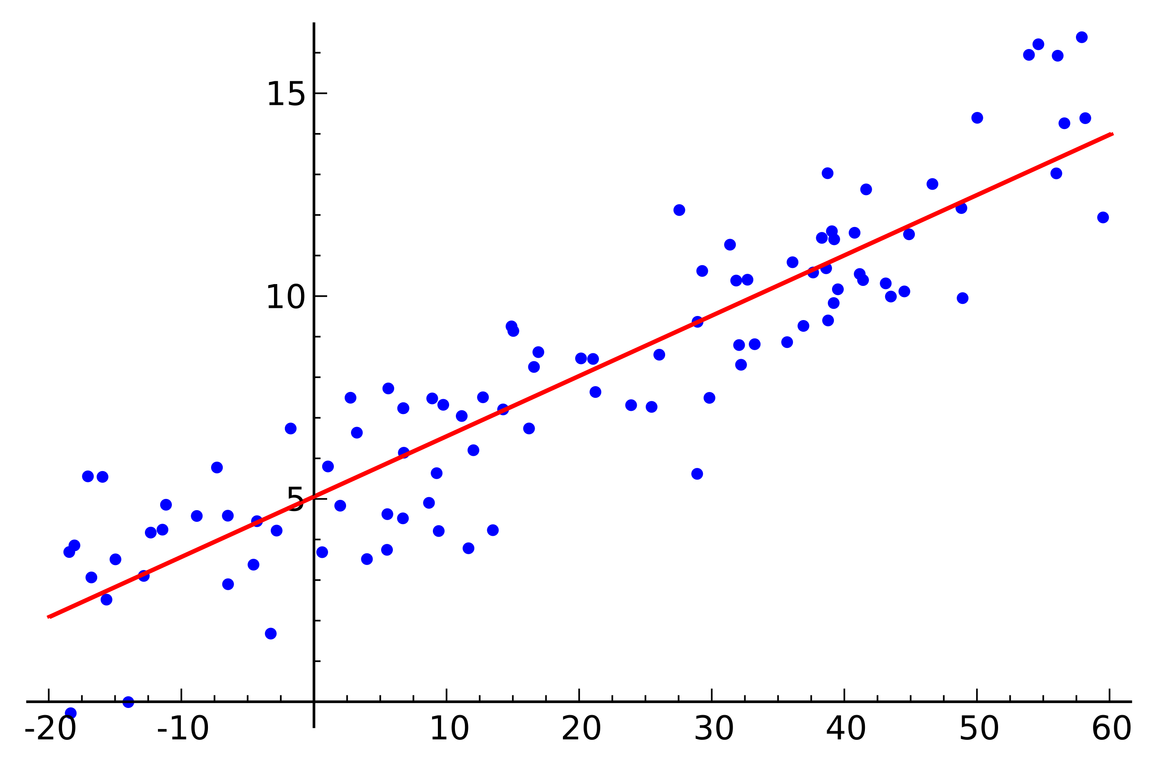
Patterns vs. Models
https://en.wikipedia.org/wiki/Cluster_analysis#/media/File:KMeans-Gaussian-data.svg
https://en.wikipedia.org/wiki/Machine_learning#/media/File:Linear_regression.svg

Slide 12

Data Mining Examples
If you buy beer, you highly likely will buy diapers (association rules)
People who have a similar profile as you like to watch these shows (recommendation systems)

Slide 13
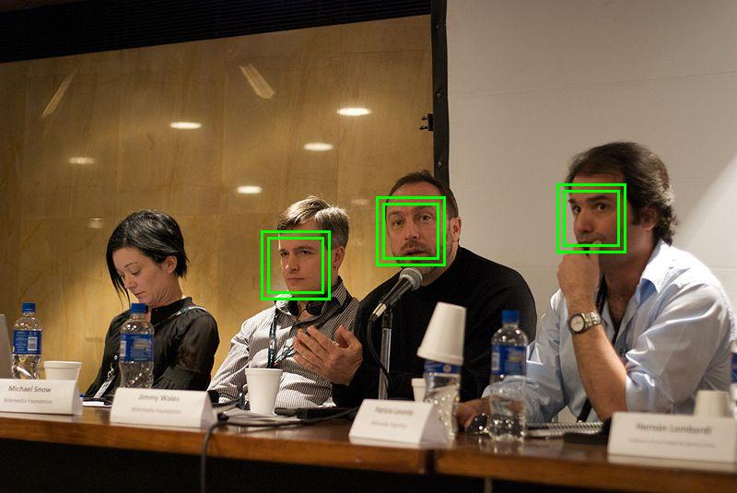
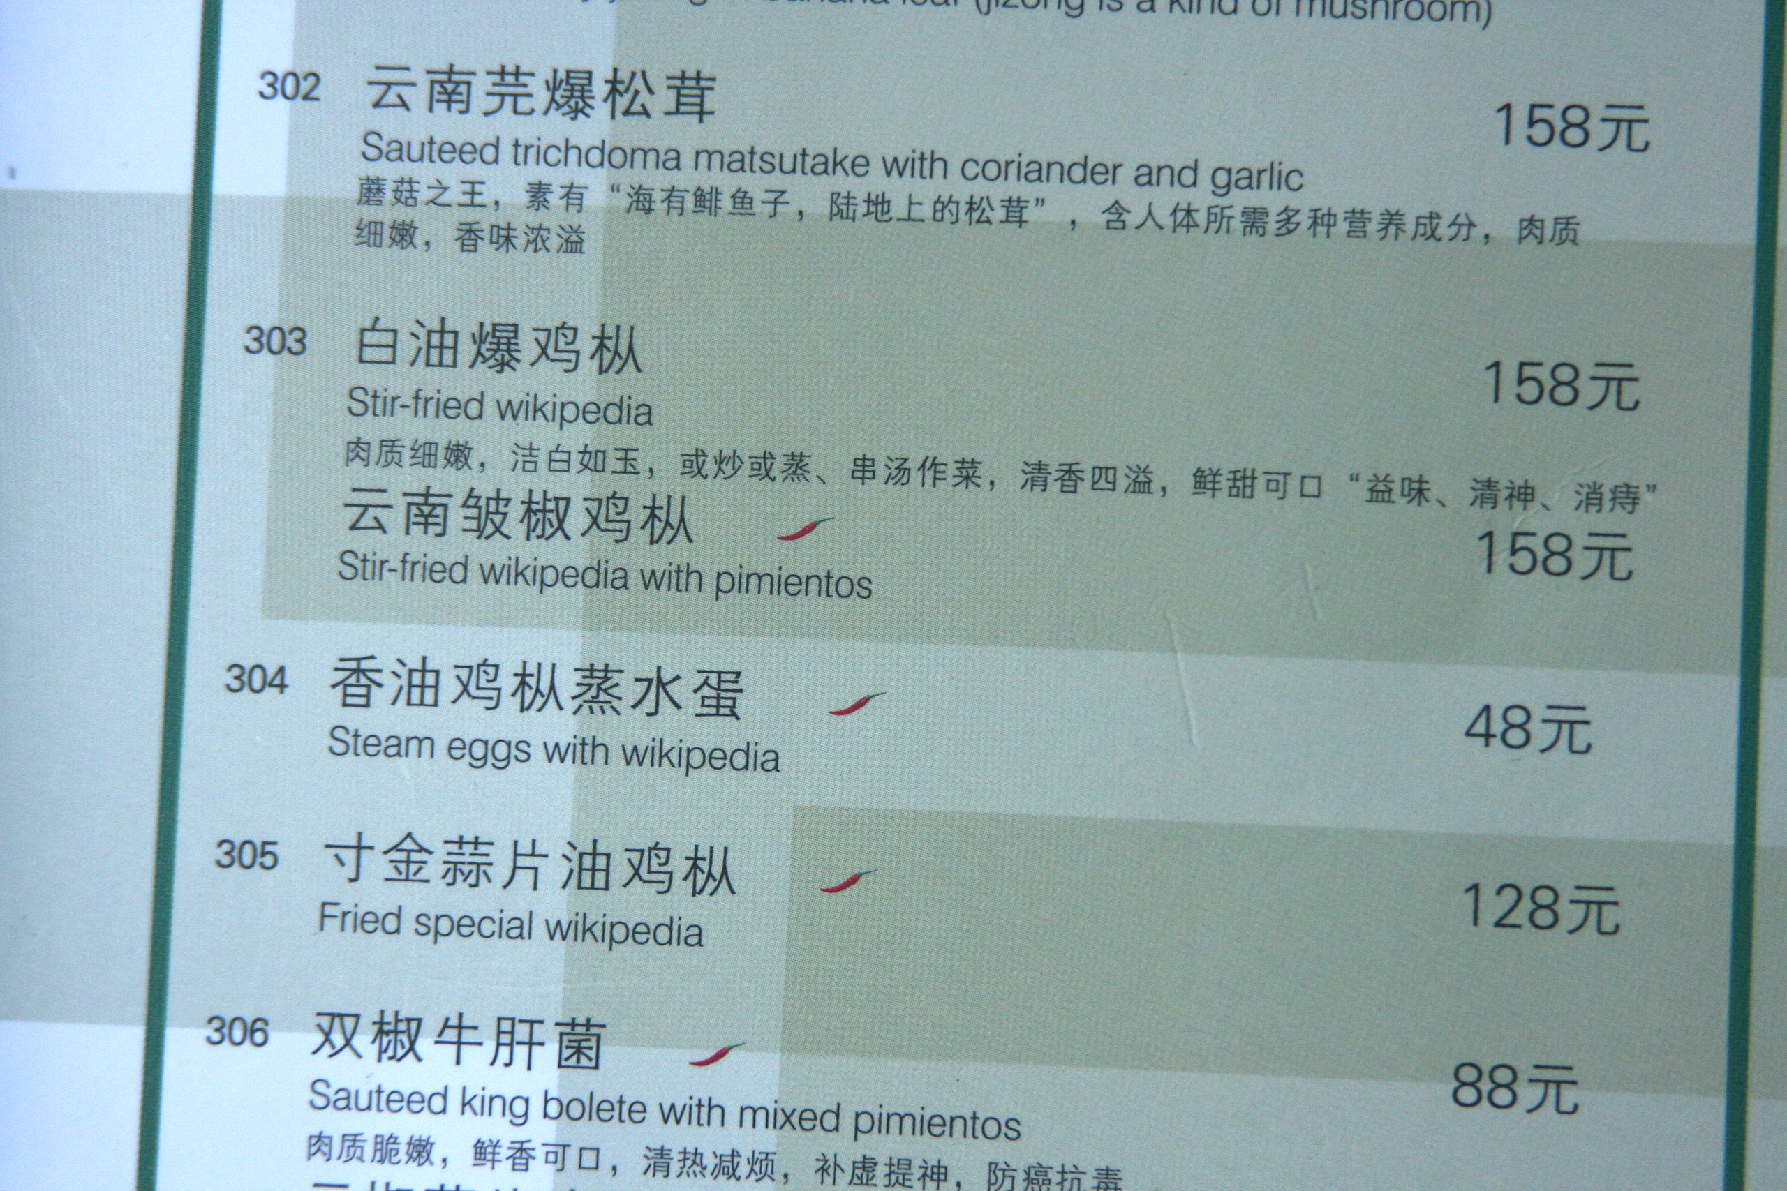
Machine Learning Examples
Face Detection (Computer Vision)
Machine Translation (Natural Language Processing)
https://en.wikipedia.org/wiki/Facial_recognition_system#/media/File:Face_detection.jpg
https://en.wikipedia.org/wiki/Machine_translation#/media/File:Stir_Fried_Wikipedia.jpg

Slide 14
What is Spatial AI?
Spatial Artificial Intelligence
AI technologies that handle spatial data, typically associated with real-world applications
Data Mining
Machine Learning
Geo-AI
Spatial Statistics
Geographic Information Science
…

Slide 15
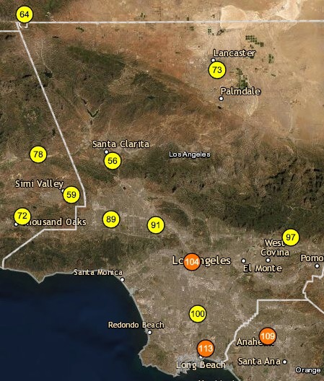
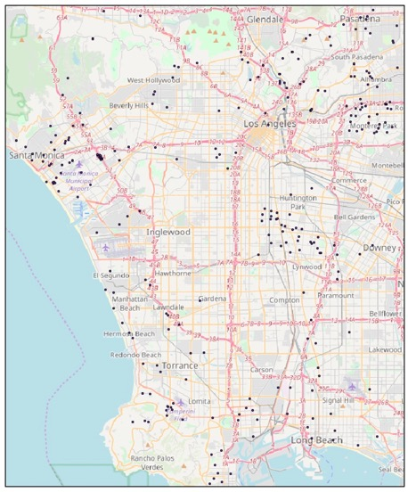
Spatial AI Example
Air Quality Prediction
South Coast AQMD Monitors
https://gispub.epa.gov/airnow/
PurpleAir Sensors
https://www2.purpleair.com/
(50km×40km geographic area)
Lin, Y., Chiang, Y. Y., Franklin, M., Eckel, S. P., & Ambite, J. L. (2020, November). Building Autocorrelation-Aware Representations for Fine-Scale Spatiotemporal Prediction. In ICDM) (pp. 352-361)

Slide 16
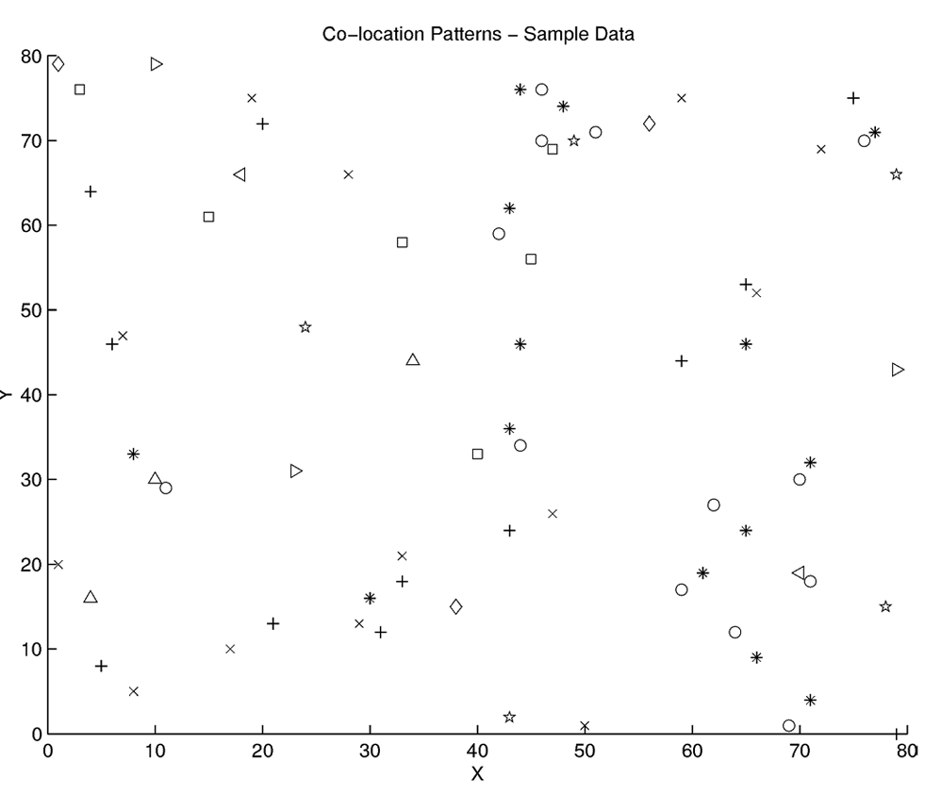
Spatial AI Example
Spatial colocation mining
Huang, Y., Shekhar, S., & Xiong, H. (2004). Discovering colocation patterns from spatial data sets: a general approach. IEEE Transactions on Knowledge and data engineering, 16(12), 1472-1485.

Slide 17
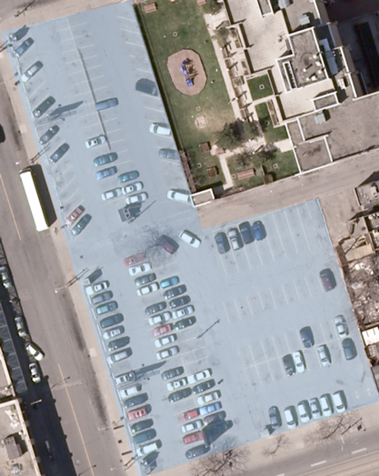
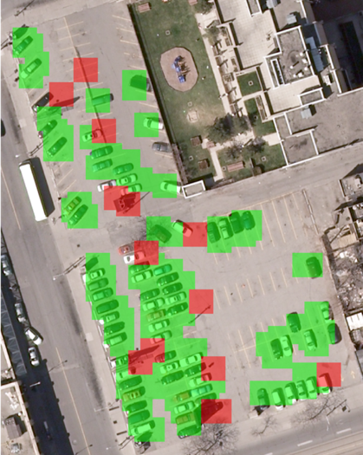
Spatial AI Example
Object detection from overhead imagery
Duan, W., Chiang, Y.-Y., Leyk, S., Uhl, J. H., and Knoblock, C. A. (December 2021). Guided Generative Models using Weak Supervision for Detecting Object Spatial Arrangement in Overhead Images. IEEE Big Data (accepted), online

Slide 18
What are Spatial Data?

Slide 19
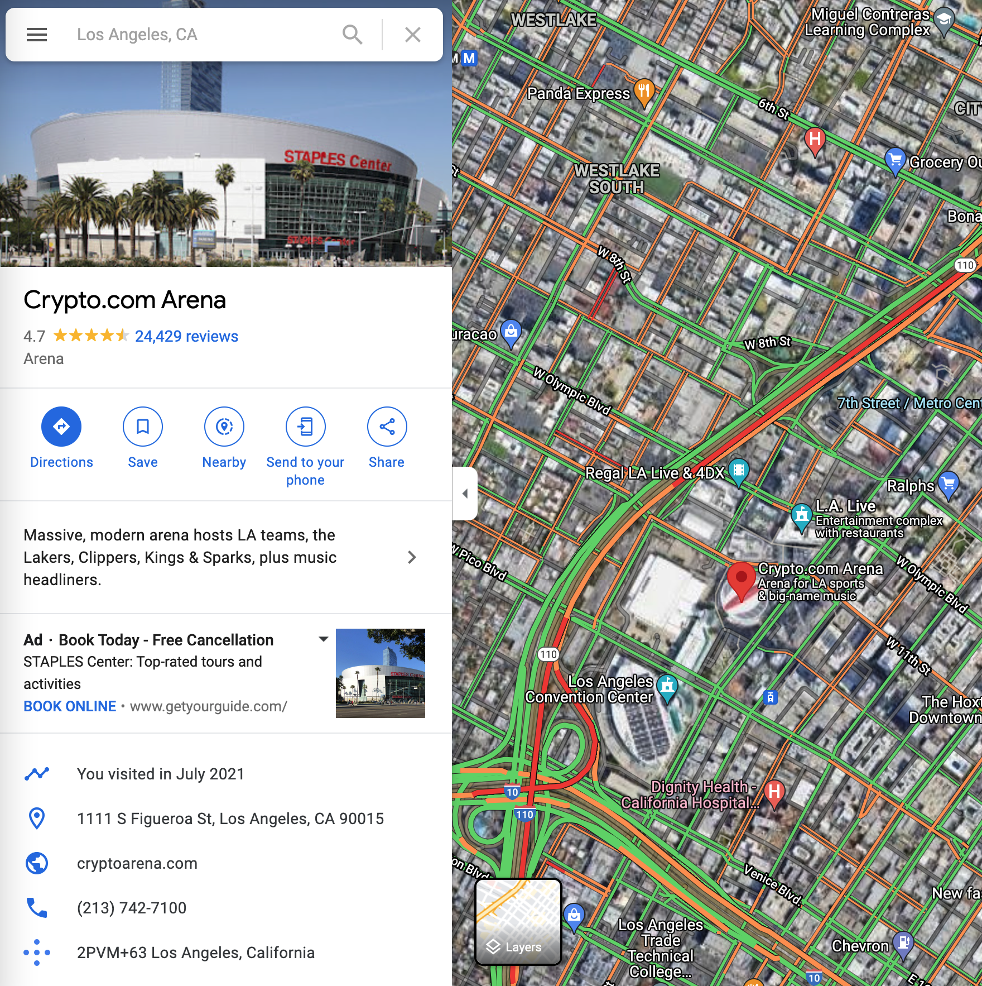
Spatial Data
Data that can spatially referenced, e.g.,
Time series from fixed-site sensors (e.g., traffic, air quality)
Remotely sensed data (e.g., satellite imagery)
Geotagged photos and tweets
Documents mentioning location entities
Notes:
https://www.youtube.com/watch?v=XbnLkc6r3yc

Slide 20
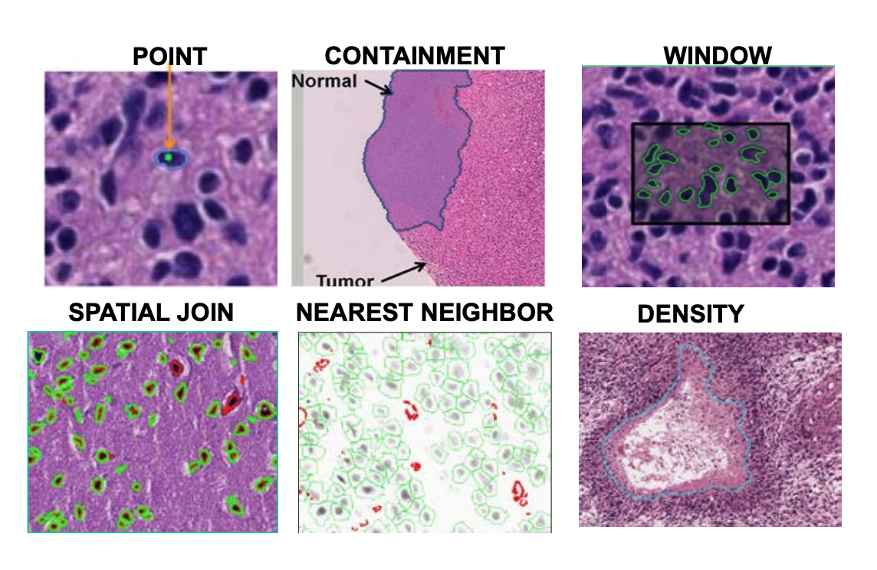
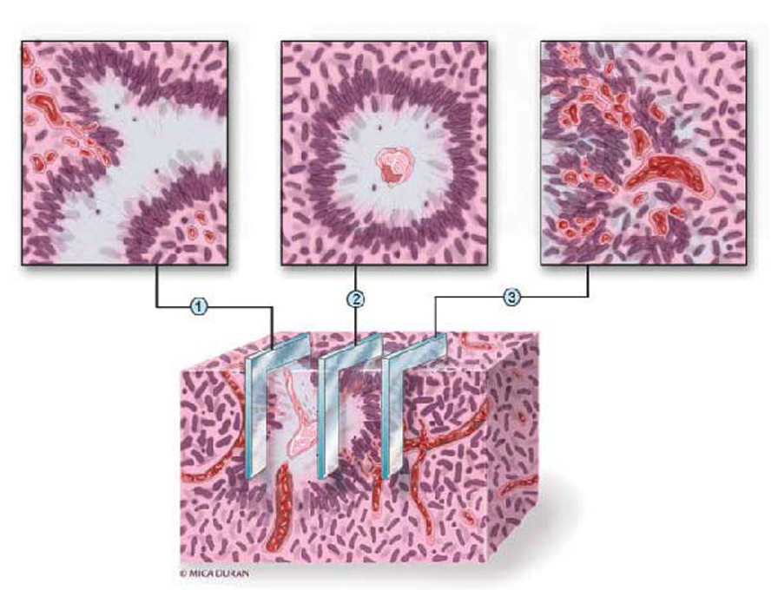
Spatial Data Do Not Have to be Geo Data
Digital Pathology Example
Rong, Y., Durden, D. L., Van Meir, E. G., & Brat, D. J. (2006). ‘Pseudopalisading’necrosis in glioblastoma: a familiar morphologic feature that links vascular pathology, hypoxia, and angiogenesis. Journal of Neuropathology & Experimental Neurology, 65(6), 529-539.
Fox, Geoffrey & Qiu, Judy & Crandall, David & von Laszewski, Gregor & Jha, Shantenu & Wang, Fusheng & Marathe, Madhav & Paden, J. & Cheatham, Tom & Beckstein, Oliver. (2016). Datanet: CIF21 DIBBs: Middleware and High Performance Analytics Libraries for Scalable Data Science NSF14-43054 Progress Report.

Slide 21
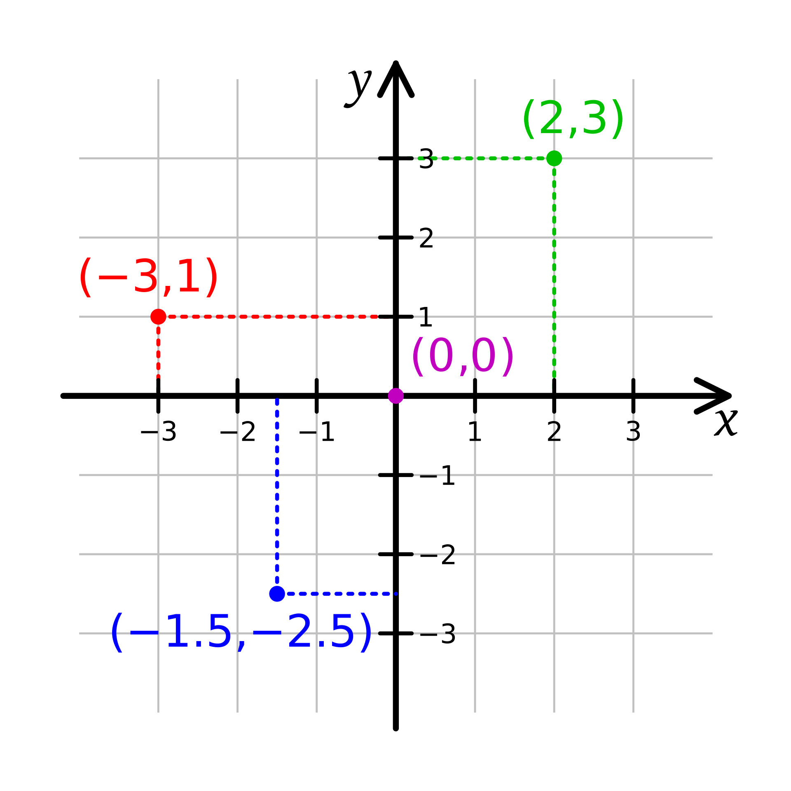
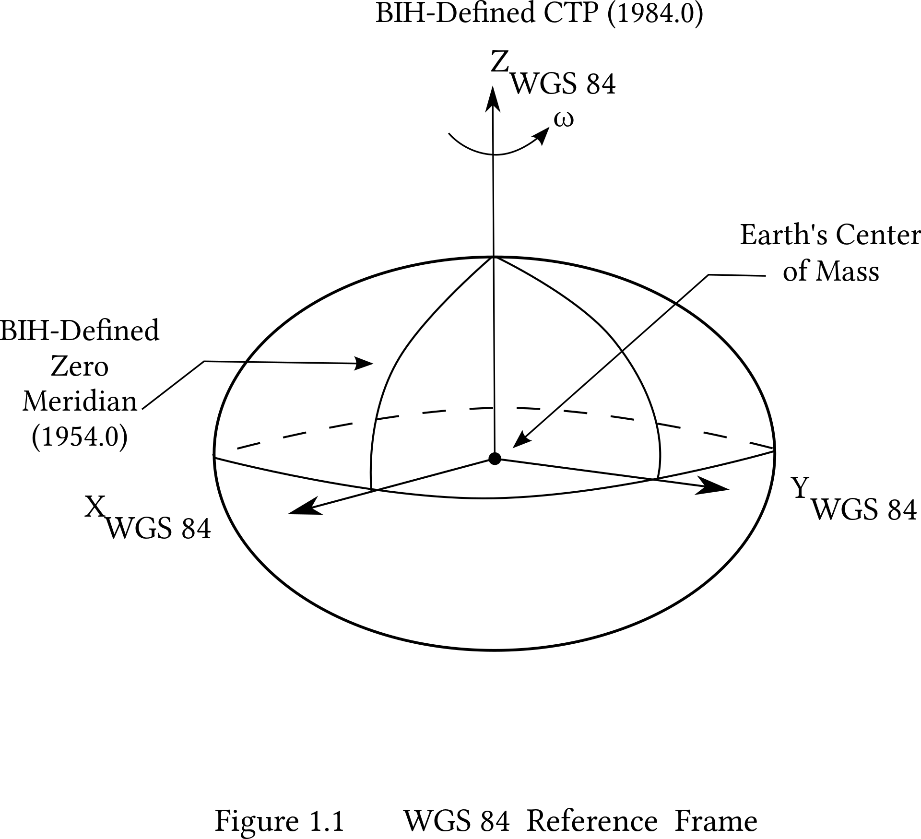
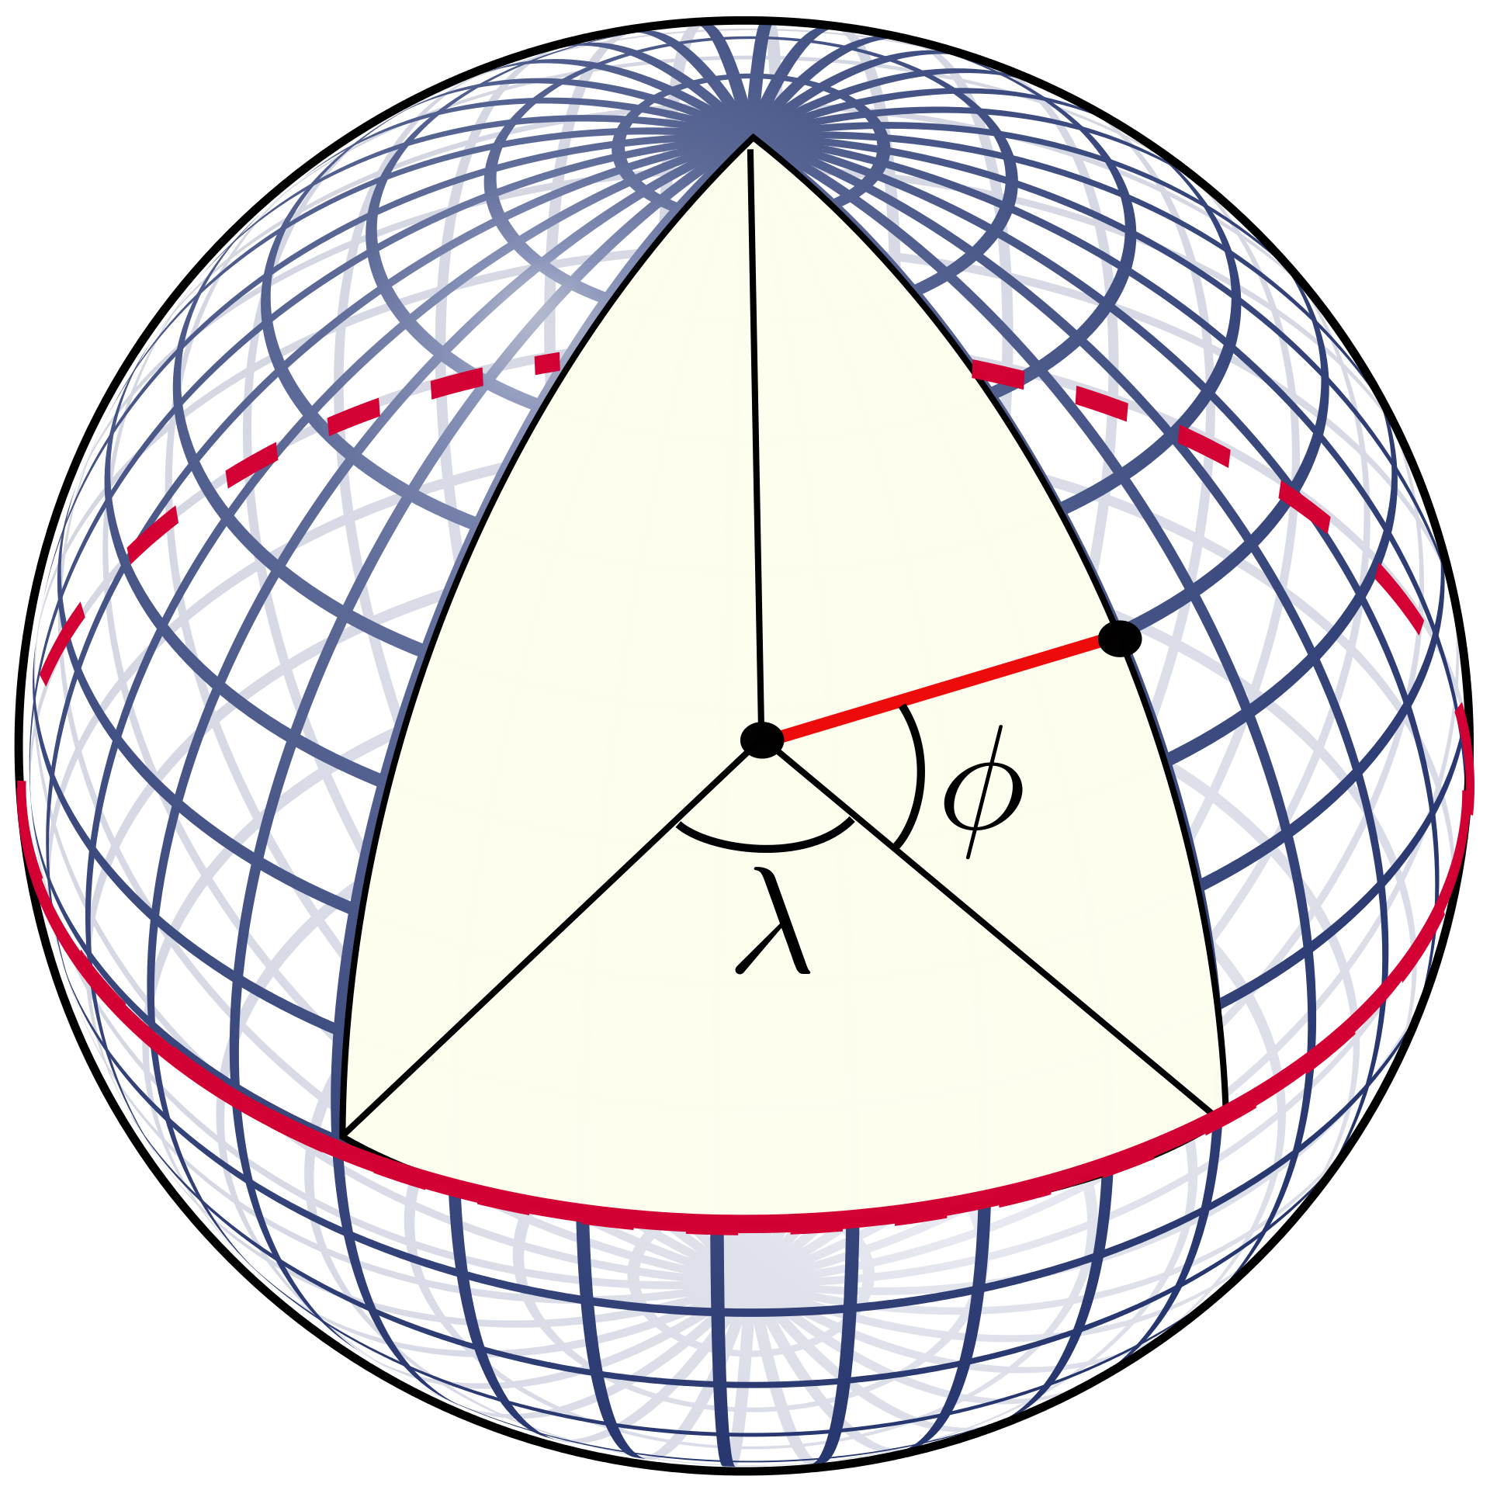
What does “spatially referenced” mean?
Spatial Coordinates
Spatial Reference System
e.g., latitude and longitude; X and Y
e.g., WGS84; Cartesian System
https://en.wikipedia.org/wiki/Geographic_coordinate_system#/media/File:Latitude_and_longitude_graticule_on_a_sphere.svg
https://en.wikipedia.org/wiki/Cartesian_coordinate_system#/media/File:Cartesian-coordinate-system.svg
https://en.wikipedia.org/wiki/World_Geodetic_System#/media/File:WGS_84_reference_frame_(vector_graphic).svg

Slide 22
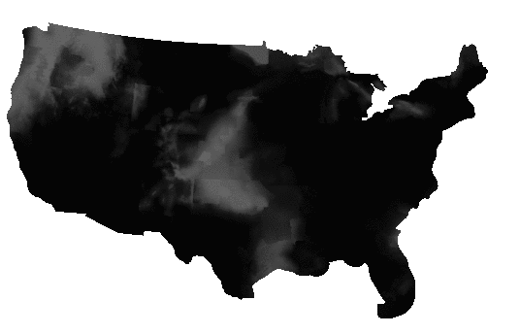
Spatial Data Representations – Raster Data
Probability of precipitation
https://blog.crunchydata.com/blog/postgis-raster-and-crunchy-bridge

Slide 23
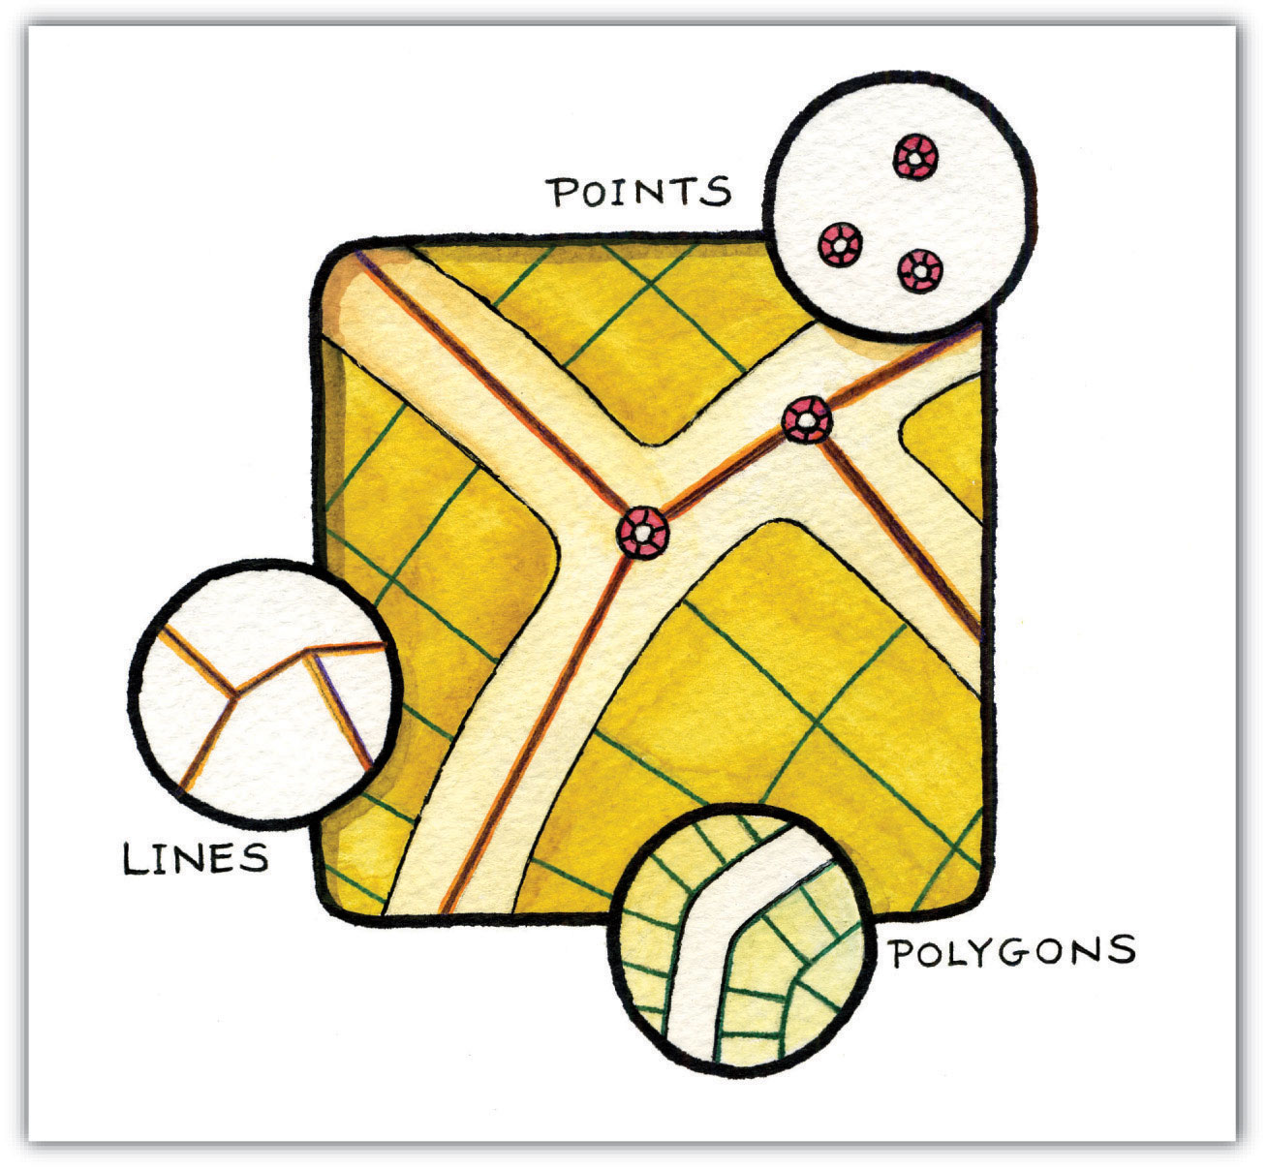
Spatial Data Representations – Vector Data
https://saylordotorg.github.io/text_essentials-of-geographic-information-systems/s08-02-vector-data-models.html

Slide 24


Spatial Data Management
Spatial Databases
Support spatial data manipulations using SQL like languages
Require a relational database engine
e.g., PostGIS (SF-SQL)
Spatial Big Data Platforms
Support highly parallelized spatial data manipulations
Require a Big Data processing platform
e.g., GeoMESA + Spark (MapReduce)

Slide 25
What Make Spatial Data Special?

Slide 26
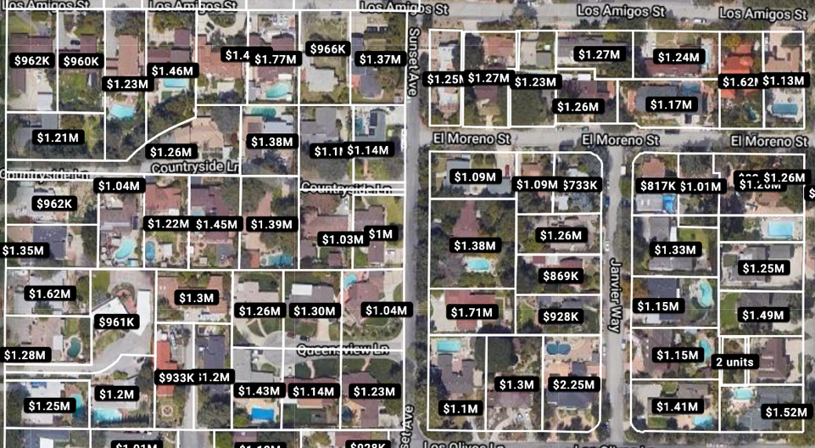

Spatial Autocorrelation
Nearby houses have similar prices

Slide 27
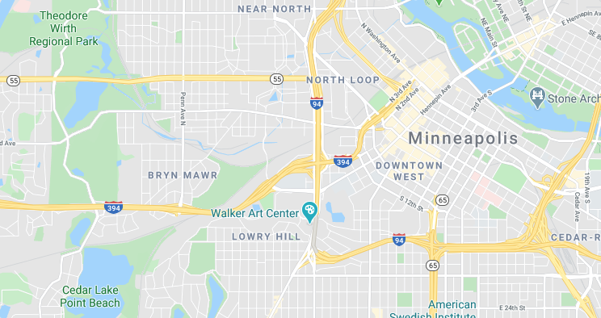

Spatial Non-stationarity
Relationships between variables can change over space
e.g., air quality near highway I-394 can be very different depending on their locations

Slide 28
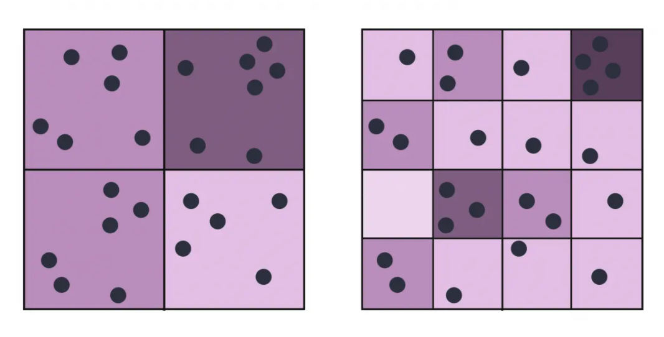
Modifiable Areal Unit Problem
Scale Effect
https://gisgeography.com/maup-modifiable-areal-unit-problem/

Slide 29
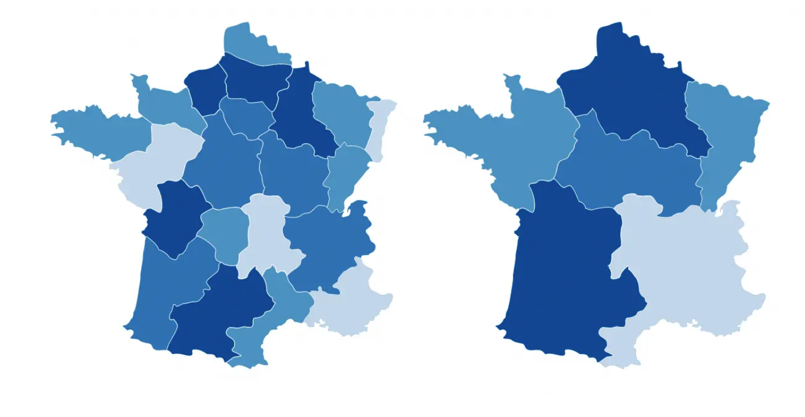
Modifiable Areal Unit Problem
Zonal Effect
https://gisgeography.com/maup-modifiable-areal-unit-problem/

Slide 30
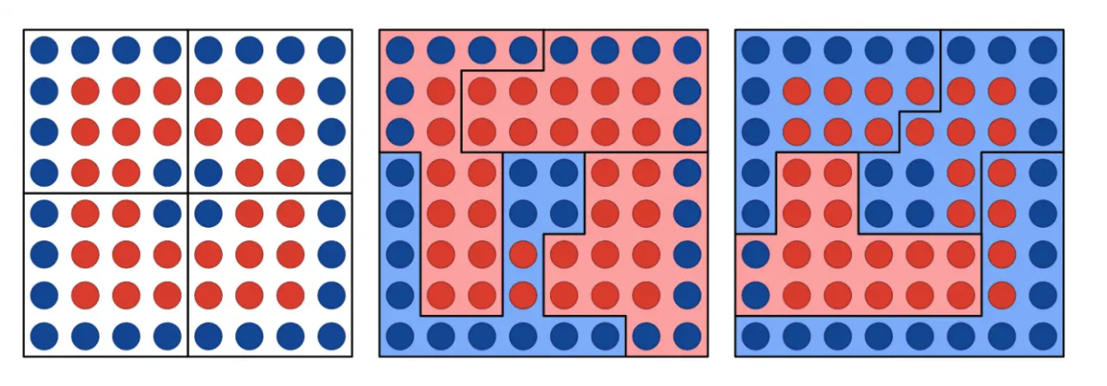
Modifiable Areal Unit Problem
Gerrymandering and Redistricting
https://gisgeography.com/maup-modifiable-areal-unit-problem/

Slide 31
Spatial Statistics

Slide 32
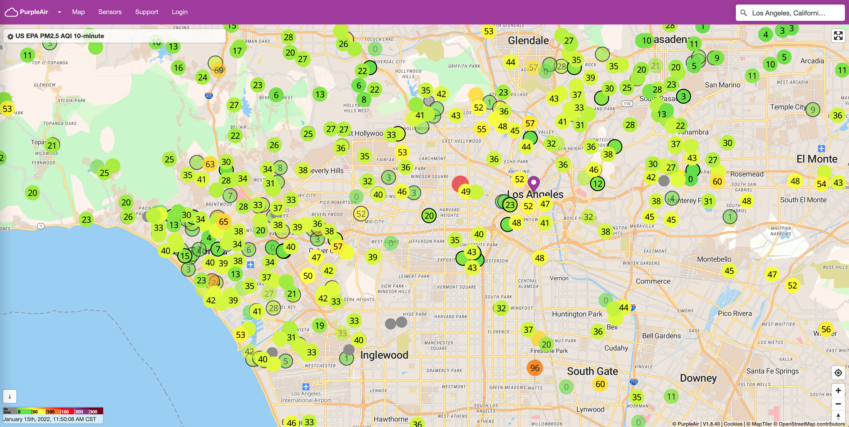
Geostatistical Data Analysis
Data that vary continuously over space, but measured only at discrete locations
Explore the spatial pattern in the observations
Quantify the spatial pattern with a function
Making predictions accounting for spatial structure

Slide 33
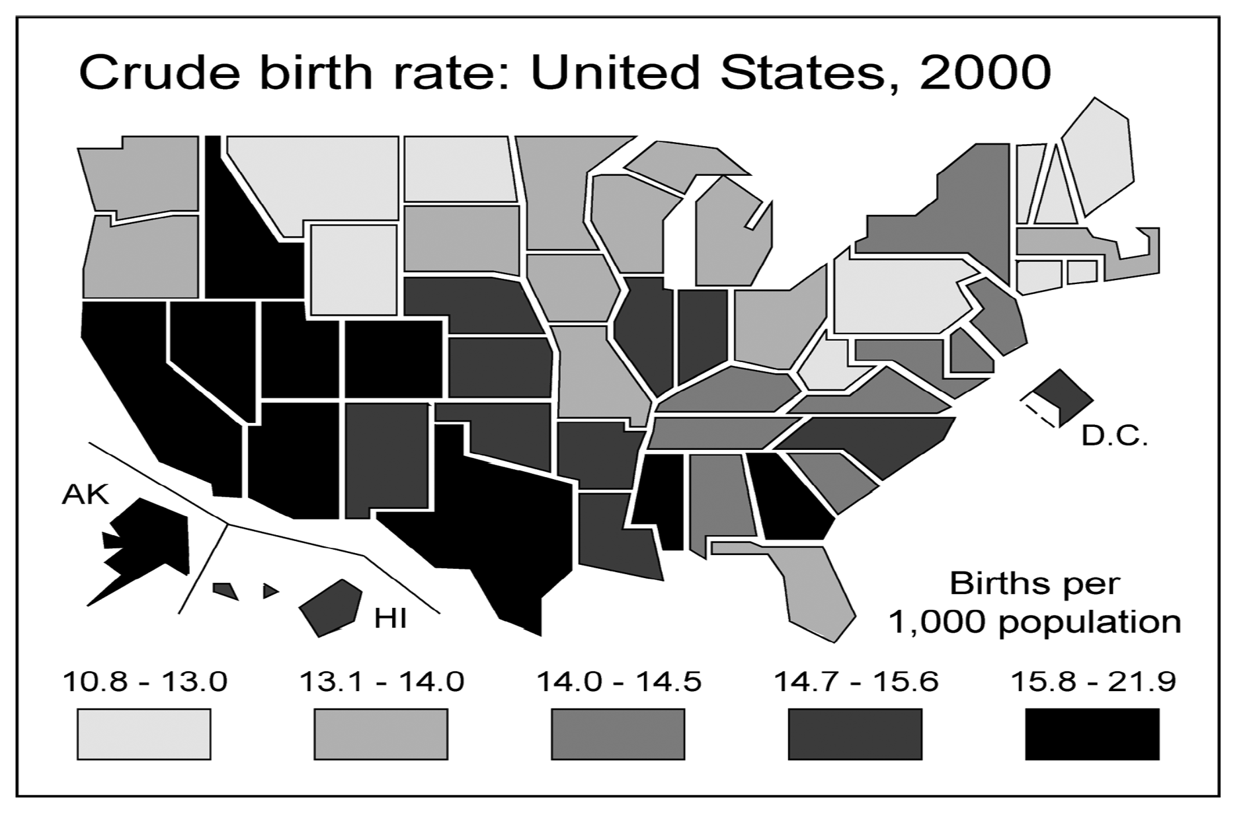
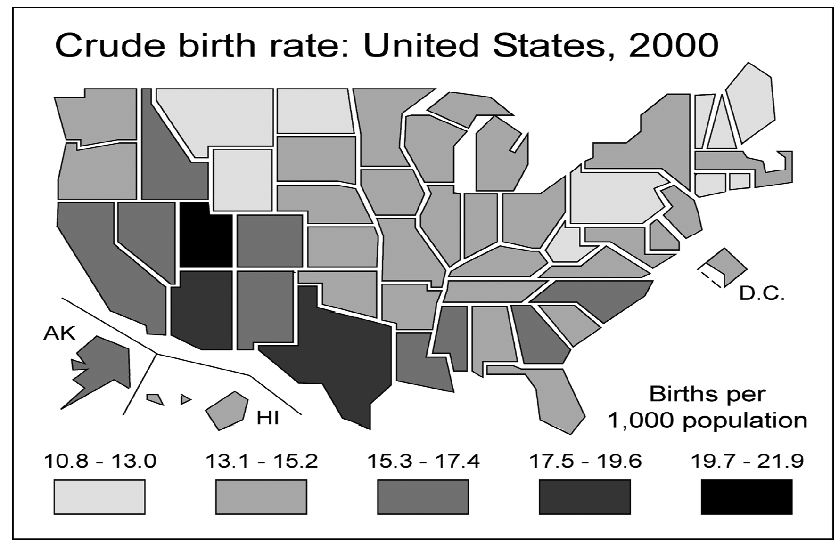
Areal Data Analysis
Understanding the linkages between areal units
e.g., if areas closer to each other are more related, how strong is this patter?
equal-interval vs quantile cut points
Monomier, N. Lying with Maps. Statistical Science 2005, 20(3) 215222.
Notes:
equal-interval vs quantile cut points

Slide 34
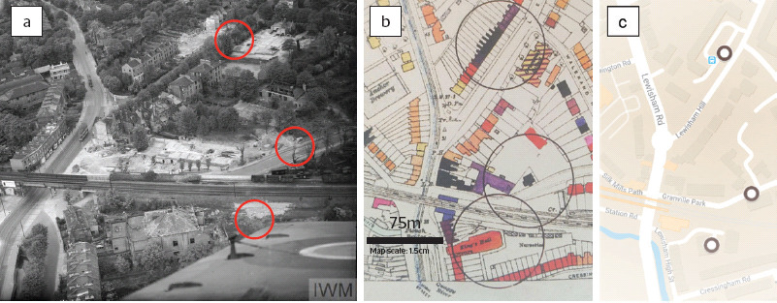
Point Pattern Analysis
Is there a regular or clustering pattern in the points?
Are points closer together than they would be by chance?
Are the points more regularly spaced than they would be by chance?
Can we define a point process that our events follow?
A cluster of three V‐1s near a railway line in Lewisham, south London. Patterns like these motivated Clarke to test whether their distribution was random. (a) A contemporary aerial photograph of the V‐1 sites, showing the large radius of destruction of houses around the bomb sites (© IWM, catalogue no. CH 15109). (b) The same region from the LCC bomb damage maps4 (p. 162), showing the three V‐1 hits (black circles). Damage to houses is coded by colour, with black indicating total destruction. (c) The same region in the Google Maps layer (hit locations V1.509–V1.511).
https://rss.onlinelibrary.wiley.com/doi/10.1111/j.1740-9713.2019.01315.x

Slide 35
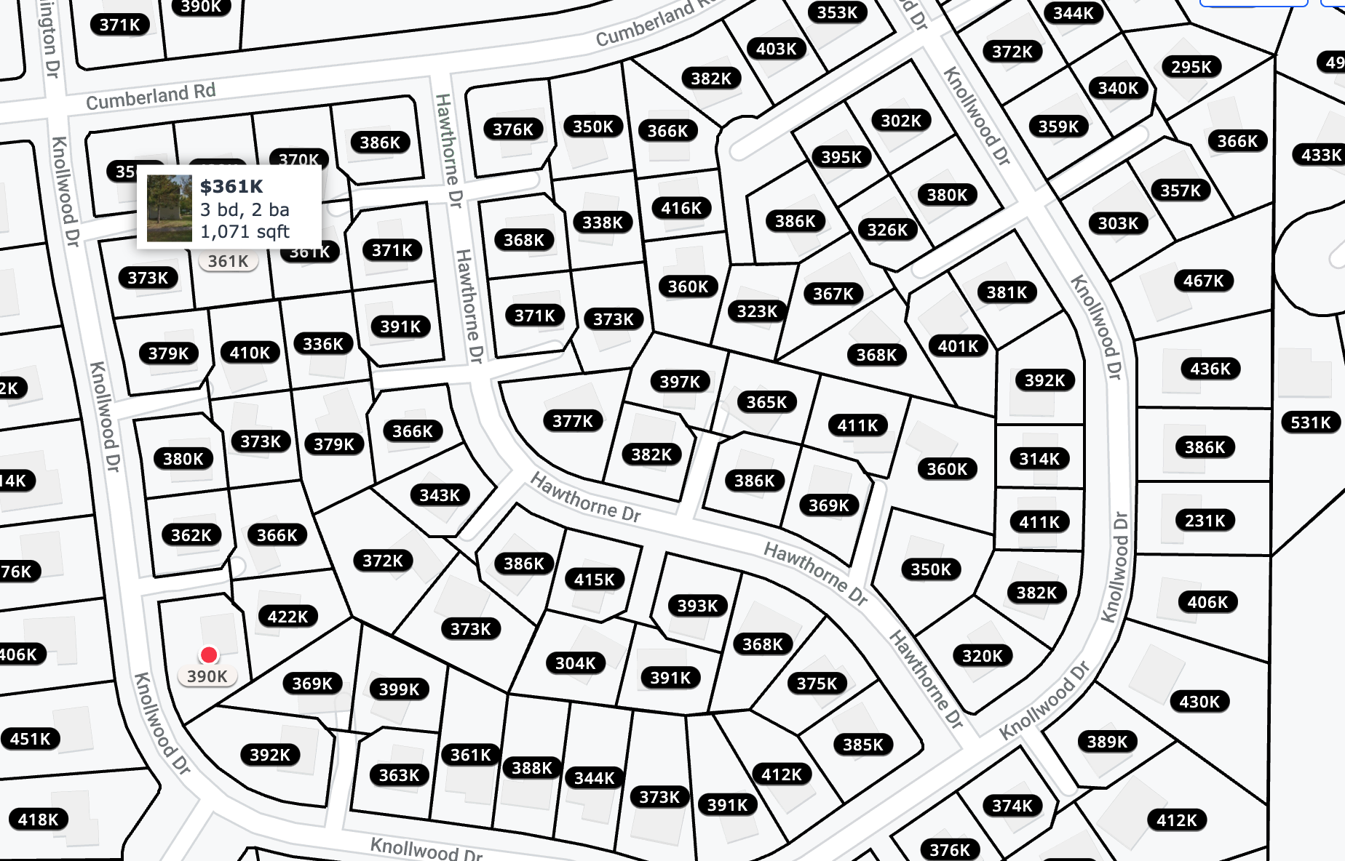
Spatial Data Analytic Example
Housing price estimate

Slide 36
K-Nearest Neighbors
9 immediate neighbors
(360+323+367+368+411+369+386+382+397)/9 = 373.66

Slide 37
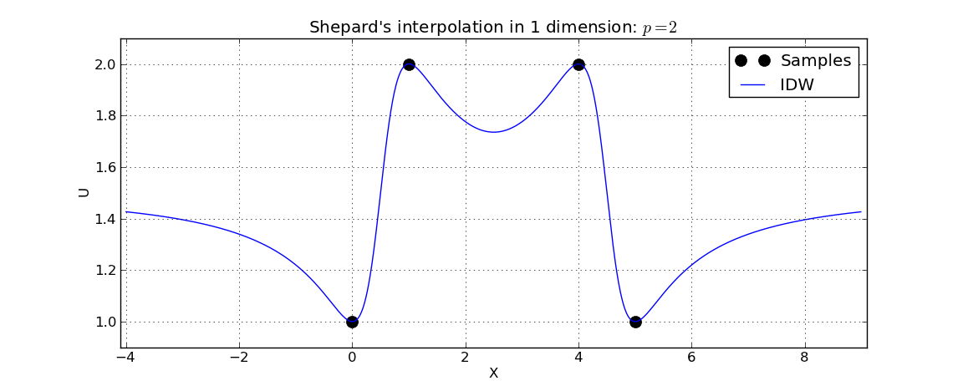
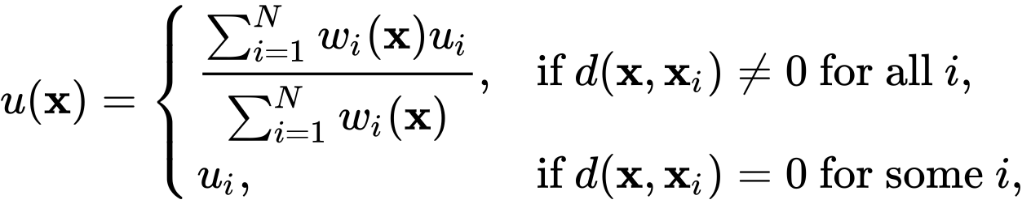
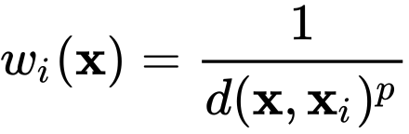
Inverse Distance Weighting
Point observations:
Interpolated value at X:
https://en.wikipedia.org/wiki/Inverse_distance_weighting

Slide 38
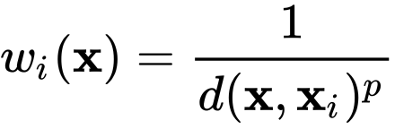
KNN & IDW
IDW, p=2
Weight = 1 for immediate neighbors
360+323+367+368+411+369+386+382+397
Weights = 1/4 for two step neighbors
1/4(401+326+386+416+338+373+377+415+393+368+350+360)
4488.75/21 = 374
Recall K-Nearest Neighbors
373.66

Slide 39
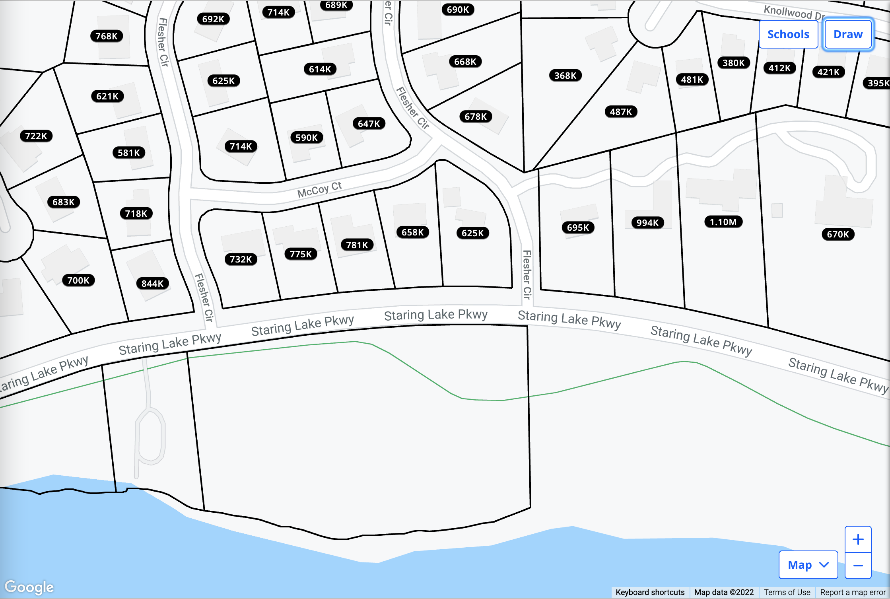
Will either KNN or IDW work here?

Slide 40
Will either KNN or IDW work here?

Slide 41
What Matters When Dealing with Spatial Data?
Modeling Spatial and Temporal Dependencies
Data-driven AI methods
Spatial statistics
Spatial modeling
Spatial analysis
Autocorrelations
Non-stationarity
MAUP
Storing and Managing Spatial Data
Unique Spatial Data Properties
Quality
Context
Representations
Scalability

Slide 42
This Course

Slide 43
Course Themes
Explore ways to store and manage spatial data, including
Spatial databases
Big Data platforms
(if we have time) Ontology and Knowledge Graph
Look into how deep learning & data mining technologies solve real-world problems utilizing the unique spatial data properties, including topics in
Location time-series data mining (e.g., air quality prediction and trajectory mining)
Computer vision (e.g., object detection from overhead imagery)
(if we have time) Natural language processing (e.g., toponym detection from documents),

Slide 44
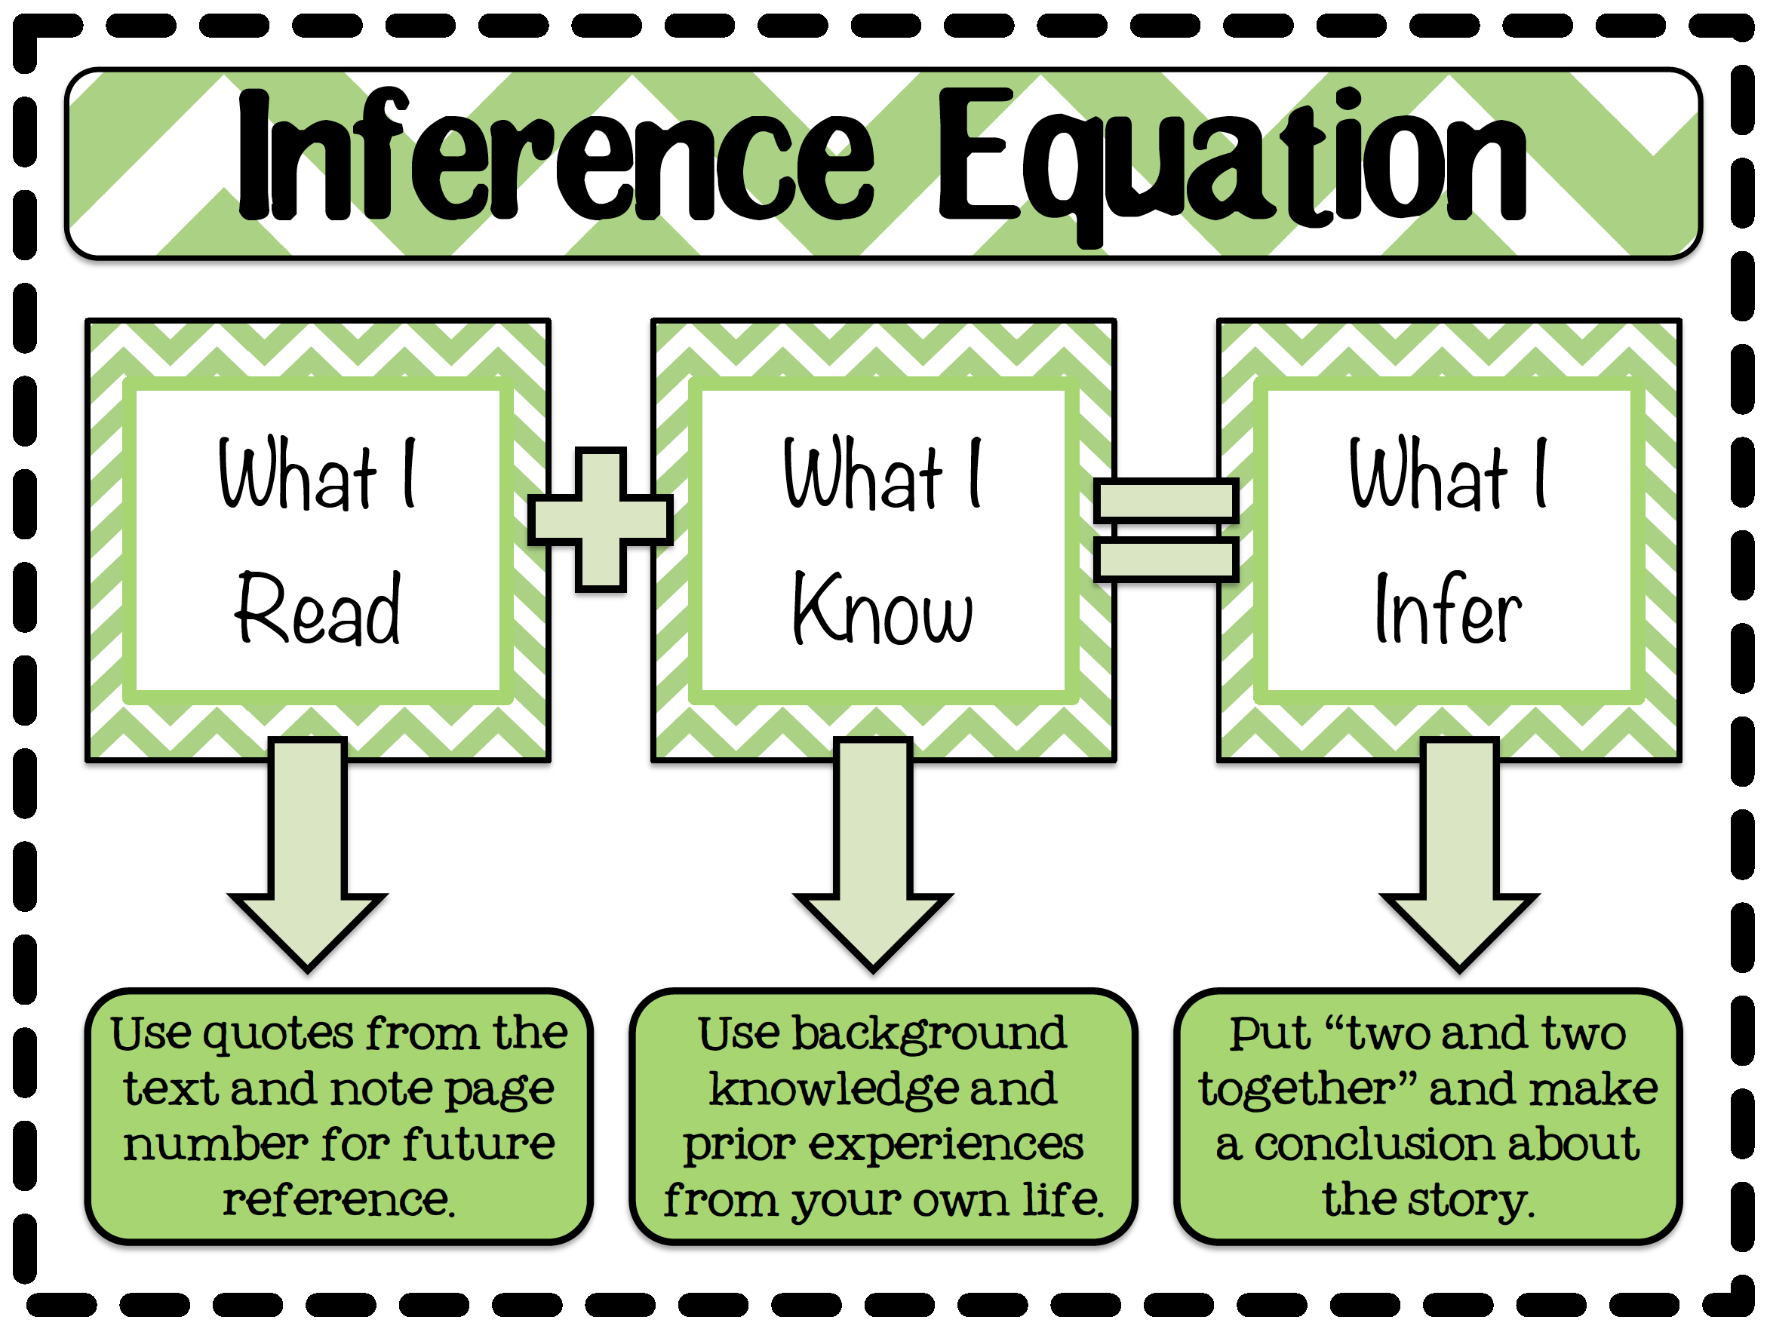
Smarter AI
Data-driven technologies that can incorporate prior knowledge derived from spatial data
https://www.teacherspayteachers.com/Product/Making-Inferences-Inference-Equation-Poster?utm_source=sendgrid&utm_medium=email&utm_campaign=post_purchase_confirmation_control&utm_content=01%2F12%2F2022

Slide 45
Prerequisites
Programming language
Python
Basic understanding of machine learning
(We will) Focus on deep learning with PyTorch
Basic understanding of databases
Some familiarity with SQL

Slide 46
Course Tools
We will provide some background of these tools, but it will be fast paced.
Postgres + PostGIS
GeoMESA + Spark
PyTorch

Slide 47
(Your) Course Work
Five Homework Assignments (50%, 10% each)
No regrading
One-week late penalty – 20%; 0 points after one week
Free five-day extensions
You can use these five days on homework however you want until the last day of the class
No more extension days will be given for any reason
You need to let your TA know if you are using free days when you submit your homework
Weekly Quizzes (30%)
Final project (20%)

Slide 48
Homework Assignments (tentative)
Using GeoMesa + Spark for efficient spatial data join & aggregation
Air quality prediction using time-series clustering and random forest
Road extraction from satellite imagery using deep learning models and existing contextual data
Air quality prediction using deep learning models and spatial heuristics
Car detection from satellite imagery using deep learning models and prior knowledge

Slide 49
Final Project Guidelines
1 or 2 people, with the following deliverables:
Proposal presentation (submit slides for grading)
Final project presentation (submit slides for grading)
Final report (4 page maximum)
MS/Senior Undergrad Students A comparison of selected state-of-the-art methods for solving a spatial AI problem (e.g., object detection from satellite imagery)
MS/PhD Students Develop a complete research work, which could be related to your research direction

Slide 50
Presentation Guidelines
Project proposal 10 mins
Final project presentation 15 mins
Your presentations need to address the following questions:
“What is the project trying to do?”,
“How is it done today, and what are the limits of current practice?”,
“What is your approach, and what is new in your approach?”,
“Who cares? If you succeed, what difference will it make?”,
“How do you know if your approach is successful?”, and
“What are the future extensions?”
This is the modified version of the famous “Heilmeier Catechism”: http://www.darpa.mil/work-with-us/heilmeier-catechism

Slide 51
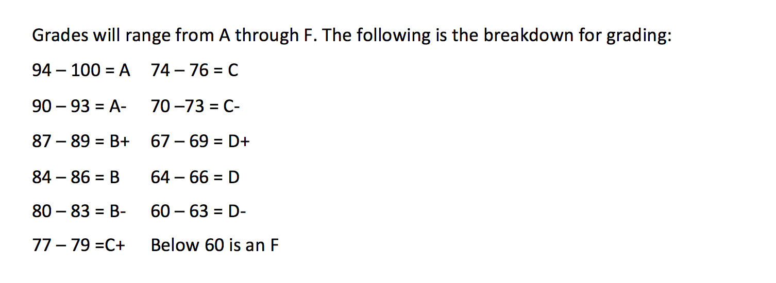
Course Grades

Slide 52
Course Staff
TAs:
Yijun Lin, lin00786@umn.edu
Zekun Li, li002666@umn.edu
Office Hours:
Instructor: Wednesdays after class
TAs: See Piazza for TA office hours and locations

Slide 53
Course Logistics
Course websites:
https://yaoyichi.github.io/spatial-ai.html
Material distributions: e.g., lecture slides (same day after the lecture)
https://piazza.com/class/ky91axj4suo9v
Discussions
Canvas
Grading, assignment submission, etc.

Slide 54
Communications
Discussion board on Piazza:
Use the discussion board for all questions and public communication with the course staff
a post on the discussion board

Slide 55
Please do not email us unless…
We will post course announcements to Piazza (make sure you check it regularly).
Emails:
Do not use emails unless it’s personal!

Slide 56
Readings
Jure Leskovec, Anand Rajaraman, Jeff Ullman, Mining of Massive Datasets
Cambridge University Press, 2012
Available free at: http://www.mmds.org/
Shashi Shekhar and Sanjay Chawla, Spatial Databases: A Tour
Prentice Hall, 2003 (ISBN 013-017480-7)
http://www.spatial.cs.umn.edu/Book/
Ian Goodfellow and Yoshua Bengio and Aaron Courville, Deep Learning
MIT Press, 2016
Available free at: https://www.deeplearningbook.org/
Additional papers

Slide 57
To-Do Items
Download the online textbook and readings
Install Spark and Postgres (plus PostGIS) on your machine
Signup for Piazza

Slide 58
Acknowledgements
Data Mining
Jure Leskovec, Anand Rajaraman, Jeff Ullman
Mining of Massive Datasets
http://www.mmds.org/
Spatial Statistics
Meredith Franklin
Spatial Statistics
https://github.com/meredithfranklin/courses/tree/master/Spatial
Deep Learning
© Alexander Amini and Ava Soleimany
MIT 6.S191: Introduction to Deep Learning
https://introtodeeplearning.com/
Gil, Yolanda (Ed.) Introduction to Computational Thinking and Data Science. Available from http://www.datascience4all.org

Slide 59

These materials are released under a CC-BY License
https://creativecommons.org/licenses/by/2.0/
You are free to:
Share — copy and redistribute the material in any medium or format
Adapt — remix, transform, and build upon the material
for any purpose, even commercially.
The licensor cannot revoke these freedoms as long as you follow the license terms.
Under the following terms:
Attribution — You must give appropriate credit, provide a link to the license,
and indicate if changes were made. You may do so in any reasonable manner,
but not in any way that suggests the licensor endorses you or your use.
Artwork taken from other sources is acknowledged where it appears.
Artwork that is not acknowledged is by the author.
Please credit as: Chiang, Yao-Yi Introduction to Spatial Artificial Intelligence. Available from https://yaoyichi.github.io/spatial-ai.html
If you use an individual slide, please place the following at the bottom: “Credit: https://yaoyichi.github.io/spatial-ai.html
We welcome your feedback and contributions.
Credit: http://www.datascience4all.org/

